Slide 1
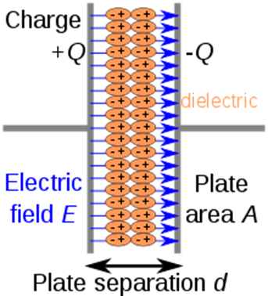
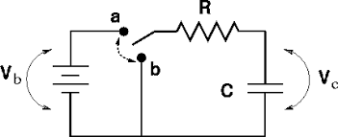
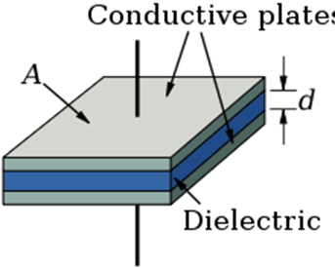
Circuit Lab
Practice #13—RC Circuits
Mr. Burleson
geaux15@hotmail.com

Slide 2
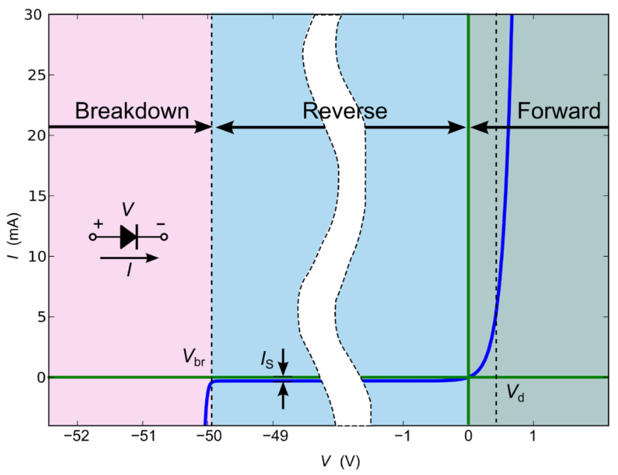
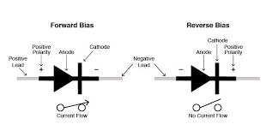
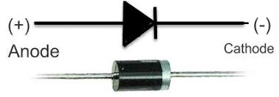
Diode (Division C Only)
A diode is a two-terminal electronic component that conducts current primarily in one direction (asymmetric conductance); it has low (ideally zero) resistance in one direction, and high (ideally infinite) resistance in the other
Ideally can be replaced with
A short (0Ω) when forward biased or closed switch
An open (∞Ω) when reverse biased or open switch
When forward biased has a small resistance and a bias depending upon semiconductor material
0.6-0.7V for Si Diodes
0.25 to 0.3V for Ge Diodes
LEDs can be as high as 4.0V
https://en.wikipedia.org/wiki/Diode

Slide 3
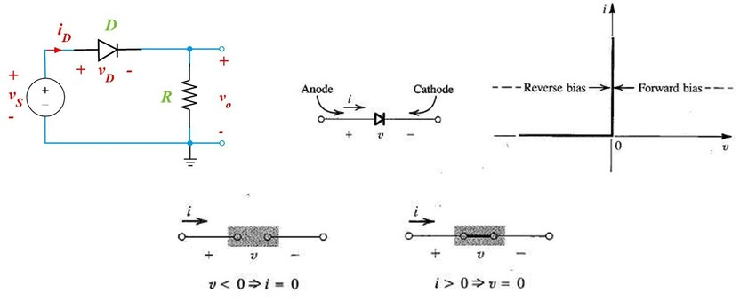
Ideal Diode
Ideal diode has zero resistance in Forward Bias with the forward bias voltage and infinite resistance in Reverse Bias.
Note that normally they assume the bias voltage is for Si ~0.7V
In Example below:
If v_{S} >= 0.7V, then the diode is in forward bias, no resistance by still account for v_{D =} 0.7V, therefore v_{o} = v_{S} – 0.7V
If v_{s} <0.7V, the diode is in reverse bias and can be treated as open
https://www.researchgate.net/figure/A-circuit-with-Ideal-Diode-its-i-v-characteristic-and-equivalent-circuits-in-the_fig12_316098112

Slide 4
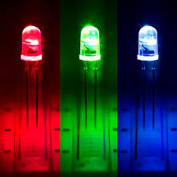
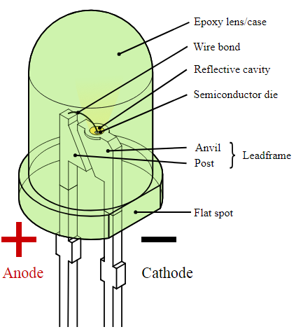
Light Emitting Diodes (LEDs)
A light-emitting diode (LED) is a two-lead semiconductor light source. It is a p–n junction diode that emits light when activated
Color is determined by the energy band gap of the semiconductor, which also affects the voltage drop
Full table has been put in the Homework Generator, LED Datasheet tab
https://en.wikipedia.org/wiki/Light-emitting_diode#cite_note-79
https://en.wikipedia.org/wiki/Light-emitting_diode

Slide 5
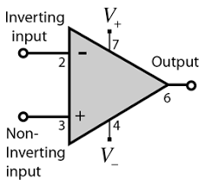
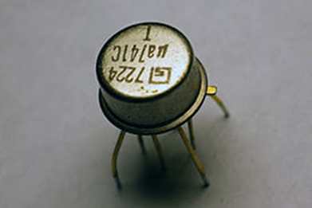
Operational Amplifiers (Division C Only)
An operational amplifier (often op-amp or opamp) is a DC-coupled high-gain electronic voltage amplifier with a differential input and, usually, a single-ended output
Very popular due to its versatility as a differential amplifier.
Can be set up easily as a comparator, inverting amplifier, or non-inverting amplifier
NEVER, EVER use a KCL at the output of an Op-Amp
https://en.wikipedia.org/wiki/Operational_amplifier

Slide 6
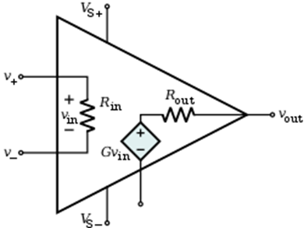
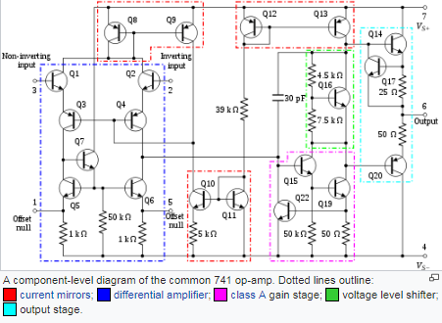
Ideal Op-Amps
Full List for Ideal Op-Amps
Infinite Open-Loop Gain (G)
Infinite Input Impedance (R_{in})
Infinite Out Voltage Range (v_{out} max)
Infinite Common-Mode Rejection Ratio
Infinite Power Supply Reject Ratio
Zero Input Offset Voltage
Zero Output Impedance (R_{out})
Zero Noise
Zero Input Current (v_{in}/R_{in})
None of these are actual
Two Golden Rules
V₊ = V₋
Current is zero at V₊ and V₋
https://en.wikipedia.org/wiki/Operational_amplifier

Slide 7
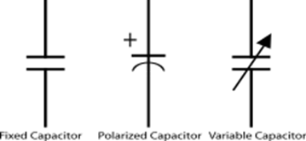
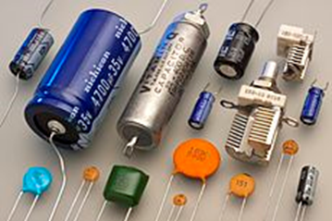
Capacitors
A capacitor is a passive two-terminal electrical component that stores potential energy in an electric field
Most capacitors contain at least two electrical conductors often in the form of metallic plates or surfaces separated by a dielectric medium (glass, ceramic, plastic, paper, mica, etc.). A conductor may be a foil, thin film, sintered bead of metal, or an electrolyte.
Unit of capacitance is a Farad (F). Most capacitors have small values like μF, pF, etc.
Charge equals Capacitance times Potential
Q = C V
https://en.wikipedia.org/wiki/Capacitor
https://courses.physics.illinois.edu/phys102/sp2013/lectures/lecture7.pdf

Slide 8
Capacitors
A capacitor consists of two conductors separated by a non-conductive region where charge builds up on both sides
When charging the current flows freely at first so it appears to be a short (with zero voltage)
When fully charged the current is completely stopped so it appears to be an open (with maximum voltage).
A capacitance of one Farad (F) means that one Coulomb of charge on each conductor causes a voltage of one Volt (V) across the device
Q = C V
https://en.wikipedia.org/wiki/Capacitor
https://courses.physics.illinois.edu/phys102/sp2013/lectures/lecture7.pdf

Slide 9
Capacitors (Parallel Plate Model)
The simplest model of a capacitor consists of two parallel plates with a thin dielectric in between.
The dielectric is much thinner than the dimensions of the plates
The dielectric permittivity (ε) of the material determines how much capacitance can be held
C = ε A / d
Energy stored in a capacitor is E = ½ CV²
Free space/vacuum has a permittivity of ε_{o} = 8.854 x 10⁻¹² F/m, all other materials are higher
https://en.wikipedia.org/wiki/Capacitor
https://courses.physics.illinois.edu/phys102/sp2013/lectures/lecture7.pdf

Slide 10
RC Circuits (Division C Only)
Most RC problems involve a Resistor (R) and a Capacitor (C), which is charged by a battery and then discharged for the start
Usually with a switch that is set to charge or discharge the capacitor
The time constant, τ = RC, is in unit of seconds
τ is the time it takes to charge a capacitor to about 63% of max value
τ is the time it takes to discharge a capacitor to about 37% of its original value
Charge and voltage don’t change instantaneously so they are the same right before and right after the switch
Current starts as a short when charging and goes to zero long term.
Current starts at maximum value (i.e. if it was a short during charging) when discharging and goes to zero long term
Common problem start conditions
Switch is set to b for a very long time
This discharges the capacitor so V_{c} = 0V
Switch is set to a for a very long time
This charges the capacitor so V_{c} = V_{b}
https://en.wikipedia.org/wiki/Capacitor
https://courses.physics.illinois.edu/phys102/sp2013/lectures/lecture7.pdf

Slide 11
RC Circuits (transient charging)
Most RC problems involve a Resistor (R) and a Capacitor (C), which is charged by a battery and then discharged
Usually with a switch that is set to charge or discharge the capacitor
The time constant, τ = RC
If starting discharged, V_{c}(t=0) = 0V
If switch is turned to a (charging position) at t=0, the capacitor begins to charge
The charge as a function of time increases Q(t) =V_{max} (1-e^{-t/RC})
Common problem solution method
Find start condition (usually either fully discharged or charged)
Determine the impact of the change at t=0 (charging or discharging)
Combine Capacitors if needed as normally
Solve for the equivalent R as seen by the Capacitor during charging
All voltage sources are treated as shorts and all current sources are treated as open
Combine normally
Determine what the maximum charged voltage (V_{max}) would be in the charging position
Calculate τ = RC
Using V_{max} and τ = RC you can resolve current and voltage or charge as a function of time
https://en.wikipedia.org/wiki/Capacitor
https://courses.physics.illinois.edu/phys102/sp2013/lectures/lecture7.pdf

Slide 12
RC Circuits (transient charging cont)
If starting discharged, V_{c}(t=0) = 0V
If switch is turned to a (charging position) at t=0, the capacitor begins to charge, usually from zero
τ = RC
V_{max} = V_{b} (since eventually the current through R goes to zero and so the voltage at V_{b} = V_{c}
The charge as a function of time increases Q(t) =(V_{max} /C)(1-e^{-t/RC})
V(t) = V_{max}(1-e^{-t/RC})
I(t) = (V_{max}/R)e^{-t/RC}
Common problem solution method
Find start condition (usually either fully discharged or charged)
Determine the impact of the change at t=0 (charging or discharging)
Combine Capacitors if needed as normally
Solve for the equivalent R as seen by the Capacitor during charging
All voltage sources are treated as shorts and all current sources are treated as open
Combine normally
Determine what the maximum charged voltage (V_{max}) would be in the charging position
Calculate τ = RC
Using V_{max} and τ = RC you can resolve current and voltage or charge as a function of time
Double check the voltage and current at t = ∞
https://en.wikipedia.org/wiki/Capacitor
https://courses.physics.illinois.edu/phys102/sp2013/lectures/lecture7.pdf

Slide 13
RC Circuits (transient discharging cont)
If starting discharged, V_{c}(t=0) = V_{b}
If switch is turned to a (discharging position) at t=0, the capacitor begins to discharge, from V_{max} τ = RC
V_{max} = V_{b} (since eventually the current through R goes to zero and so the voltage at V_{b} = V_{c}
The charge as a function of time decreases Q(t) =(V_{max} /C)(e^{-t/RC})
V(t) = V_{max}(e^{-t/RC})
I(t) = (V_{max}/R)e^{-t/RC}
Common problem solution method
Find start condition (usually either fully discharged or charged)
Determine the impact of the change at t=0 (charging or discharging)
Combine Capacitors if needed as normally
Solve for the equivalent R as seen by the Capacitor during charging
All voltage sources are treated as shorts and all current sources are treated as open
Combine normally
Determine what the maximum charged voltage (V_{max}) would be in the charging position
Calculate τ = RC
Using V_{max} and τ = RC you can resolve current and voltage or charge as a function of time
Double check the voltage and current at t = ∞
https://en.wikipedia.org/wiki/Capacitor
https://courses.physics.illinois.edu/phys102/sp2013/lectures/lecture7.pdf

Slide 14
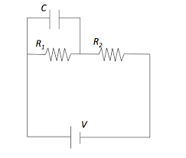
Practice
What is the time constant for charging the system to the right, if R₁ = R₂ = 1kΩ and C = 10 mF
What is the fully charged value of C if V = 12V
If after fully charged, the battery is removed (leaving an open), how long to discharge 37% of the charge?
If after fully charged, the battery is removed (leaving a short), how long to discharge 37% of the charge?
If fully discharged and the battery is added at t=0, what is the formula for I_{R2}

Slide 15
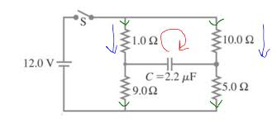
Practice
What is maximum voltage for V_{c} if the switch has been closed for a really long time
At t = 0, the switch is then opened
What is the time constant for discharging
What is the formula for V_{c}(t)
https://physicsstackexchange.com

Slide 16
Homework
Update your binder to get it competition ready
Complete the circuit problems from the Homework Generator
Level 16 Operational Amplifiers
Level 17 RC Circuits
Complete the in class practice problems using your own methods, showing all work. Make sure that your work can be followed by others.
Design an RC circuit with a 10 pF capacitor that has a maximum voltage of 10V and a time constant of 0.3 msec
Determine the equations for current, charge, and voltage as a function of time for the capacitor in that design

