Slide 1
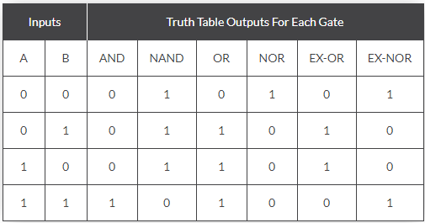
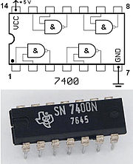
Circuit Lab
Practice #Digital Logic
Mr. Burleson
geaux15@hotmail.com

Slide 2
Digital or Boolean Logic
Boolean Algebra deals mainly with the theory that both logic and set operations are either “TRUE” or “FALSE” but not both at the same time
All inputs and outputs are either “TRUE” or “FALSE”
Inputs and Outputs are normally shown in a Truth Table
There are multiple electronic logic circuits and devices including relays, switches, diodes, discrete electronics, etc.
Basic Logic Functions include
AND (all inputs must be True for the output to be True, otherwise output is False)
OR (all inputs must be False for the output to be False, otherwise output is True)
NOT (the output is always the opposite of input, so if the input is True then the output is False and if the input is False the output is True)
https://en.wikipedia.org/wiki/Boolean_algebra
https://en.wikipedia.org/wiki/Logic_gate
https://www.electronics-tutorials.ws/boolean/bool_1.html

Slide 3
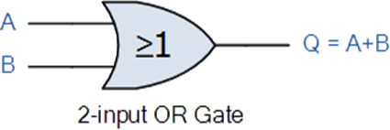
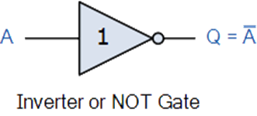
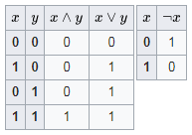
AND, OR, and NOT
Three most common and basic
NOT is also called an Inverter
0 means False and 1 means True
You can also show a NOT by a Bar over an Input or Function
NOT X can also be shown by X
NOT A & B can be shown by A & B
https://en.wikipedia.org/wiki/Boolean_algebra
https://en.wikipedia.org/wiki/Logic_gate
https://www.electronics-tutorials.ws/boolean/bool_1.html

Slide 4
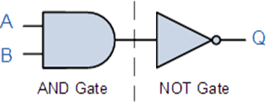
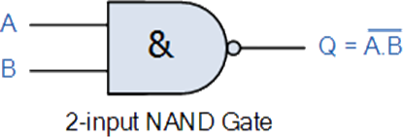
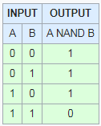
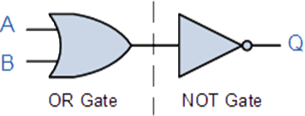
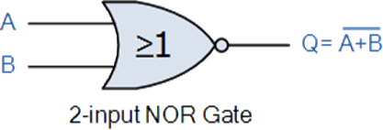
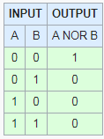
NAND and NOR
NAND = AND combined with a NOT
NOR = OR combined with a NOT
https://en.wikipedia.org/wiki/Boolean_algebra
https://en.wikipedia.org/wiki/Logic_gate
https://www.electronics-tutorials.ws/boolean/bool_1.html

Slide 5
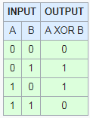
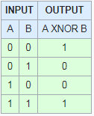
XOR and XNOR
XOR is true only if A OR B is TRUE, FALSE for all other conditions
XNOR is true only if A NOR B is TRUE, FALSE for all other conditions
https://en.wikipedia.org/wiki/Boolean_algebra
https://en.wikipedia.org/wiki/Logic_gate
https://www.electronics-tutorials.ws/boolean/bool_1.html

Slide 6
Common Truth Table
https://en.wikipedia.org/wiki/Boolean_algebra
https://en.wikipedia.org/wiki/Logic_gate
https://www.electronics-tutorials.ws/boolean/bool_1.html

Slide 7
De Morgan’s Laws
The complement of the union of two sets is the same as the intersection of their complements; and
The complement of the intersection of two sets is the same as the union of their complements
There are several ways to write this in English and notation, please try to have them all in your binder as you don’t know which one they will want to use
https://en.wikipedia.org/wiki/De_Morgan%27s_laws

Slide 8
Equivalents
NOT equivalents
In class practice, Create equivalents for the following using AND, OR, and NOT gates
NAND
NOR
XOR
XNOR
https://en.wikipedia.org/wiki/Boolean_algebra
https://en.wikipedia.org/wiki/Logic_gate
https://www.electronics-tutorials.ws/boolean/bool_1.html

Slide 9
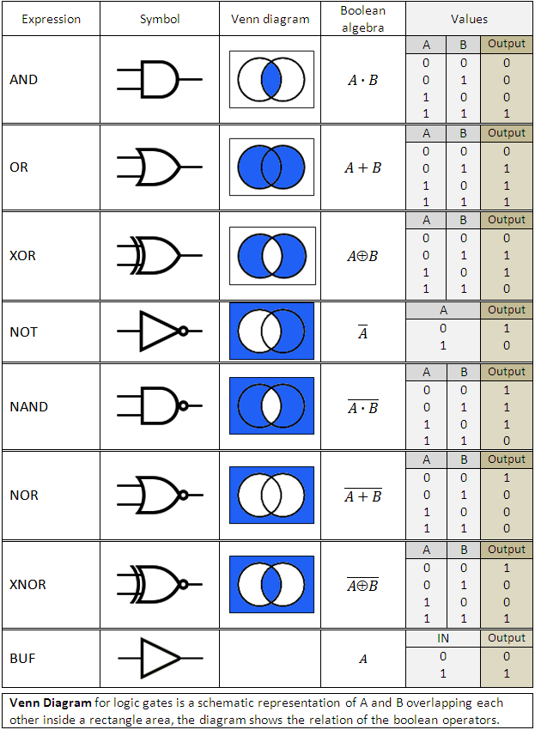
Common Logic Expressions
These are the most common expressions, symbols, and values for one or two input logic gates
Note all the ways you can show the functions
Please note that in addition
X AND Y can be shown as X Λ Y
X AND Y can be shown as X V Y
NOT X can be shown as X
Г
http://www.ambrsoft.com/Equations/LogicalGates/LogicalGates.htm

Slide 10
Common Logic Expressions
Very common Basic Boolean (logic) algebra laws
Not allowed per rule 3.e
http://www.ambrsoft.com/Equations/LogicalGates/LogicalGates.htm

Slide 11
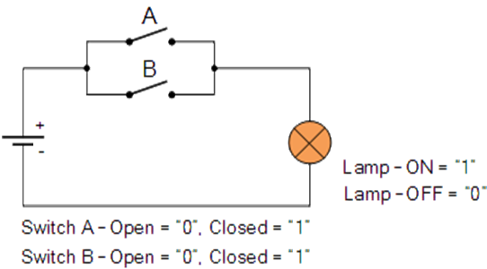
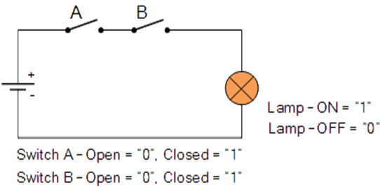
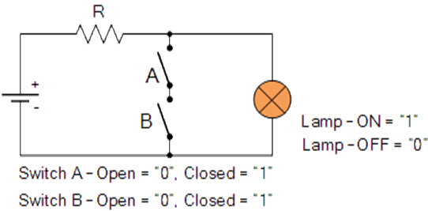
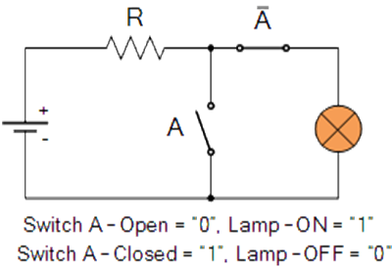
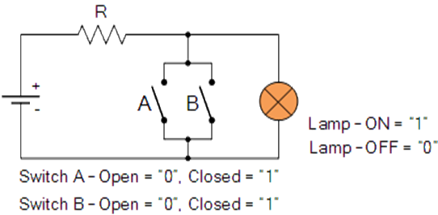
Switch Representation
Which logic gate is represented by the following?
https://en.wikipedia.org/wiki/Boolean_algebra
https://en.wikipedia.org/wiki/Logic_gate
https://www.electronics-tutorials.ws/boolean/bool_1.html

Slide 12
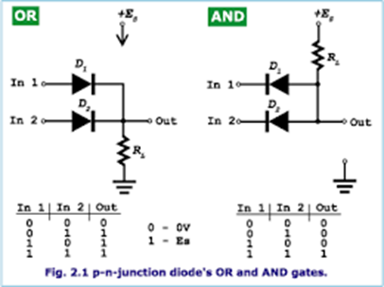
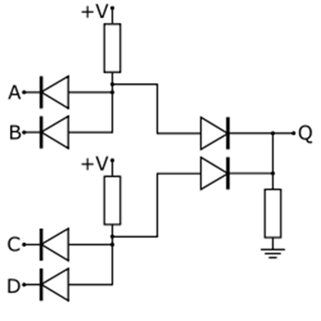
Using Diodes
Logic gates can also be represented by diodes
What is the diagram to the right representing?
Can you create a NOT out of a Diode circuit?
https://www.seminarsonly.com/Engineering-Projects/Physics/Logic-Gate.php
https://en.wikipedia.org/wiki/Diode_logic

Slide 13
Homework
Update your binder to get it competition ready
Find all the different ways to write De Morgan’s Laws
Find all the different ways to represent AND, OR, NOT, NAND, NOR, XOR, and XNOR.
Create switch and diode representations of each of the logic gates, without using transistors
Using Boolean logic gates and the following inputs, designa system which determines if something is a mammal or not
A—has a vertebrae
B—has a neocortex in the brain
C—is a animal
D—has hair
E—breathes oxygen
Using two resistors, an op amp, and an independent voltage source create a logical NOT gate
Using that NOT gate plus diodes and resistors create NAND and NOR gates

