Slide 1
2018 MICROBE MISSION(B/C)
KAREN LANCOUR
National Rules Committee
Chairman – Life Sciences
GREG PALMER
National Event
Supervisor

Slide 2
Event Rules – 2018
DISCLAIMER
This presentation was prepared using draft rules. There may be some changes in the final copy of the rules. The rules which will be in your Coaches Manual and Student Manuals will be the official rules.

Slide 3
Event Rules – 2018
BE SURE TO CHECK THE 2018 EVENT RULES FOR EVENT PARAMETERS AND TOPICS FOR EACH COMPETITION LEVEL

Slide 4
TRAINING MATERIALS
Training Power Point – content overview
6 Training Handouts - content area information and
Microscope Review – Review of use light microscope and kinds of microscopes
Practice Activities – sample stations with key
2 Sample Tournament – sample problems with key
Event Supervisor Guide – event prep tips, setup
needs and scoring tips
Internet Resources & Training Materials – on the Science Olympiad website at www.soinc.org under Event Information
A Biology-Earth Science CD, a Microbe Mission CD and the Division B and Division C Test Packets are available from SO store at www.soinc.org

Slide 5
MICROBE MISSION(B/C)
Event Description - lab-oriented competition to answer questions, solve problems and analyze data pertaining to various microbes
Event – lab practical in stations
Event Parameters – be sure to check the rules for resources allowed, type of goggles needed.

Slide 6
MICROBES
The term microbe is short for microorganism which means small organism – observed with a microscope
Over 99% of microbes contribute to the quality of human life
A small minority cause disease – in humans by sheer numbers or producing powerful toxins
The major groups of microbes are bacteria, Archaea, algae, fungi, protozoa & viruses
In terms of numbers, microbes represent most of the diversity of life on Earth and are found in every environment.

Slide 7
Content Handouts
General Overview
Major Groups of Microbes
Microbes and Ecology
Microbes and Industry
Microbes and Food
Microbes and Disease

Slide 8
2018 Microscope Review
A special training handout covering
Relative Size of Microbes
Types of Microscopes – their uses, advantages and disadvantages
Parts of a Light Microscope and their function
Principles of Microscopy

Slide 9
RELATIVE SIZE OF MICROBES

Slide 10
Prokaryotic vs. Eukaryotic
Prokaryotic – single cell with nuclear material but no nuclear membrane or membrane bound organelles
Eukaryotic – most cells – with organized nucleus and membrane bound organelles

Slide 11
Cellular vs. Acellular
Acellular – Viruses do not have cellular components, nor do they grow or metabolize organic materials. They generally consist of a piece of nucleic acid encased in protein which must use the cellular components of a living cell to reproduce.
Prions (proteinaceous infectious particles) are infectious agents composed primarily of protein which induce the existing polypeptides in host cells to take on its form.
Cellular – bacteria and Archaea are prokaryotic cells while algae, fungi, and protozoa have eukaryotic cells.

Slide 12
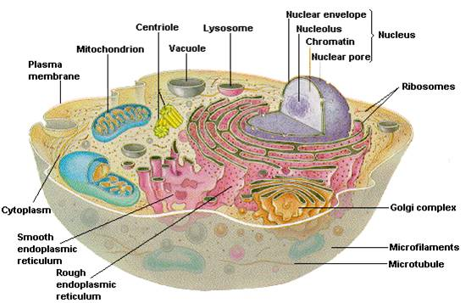
Animal Cell

Slide 13
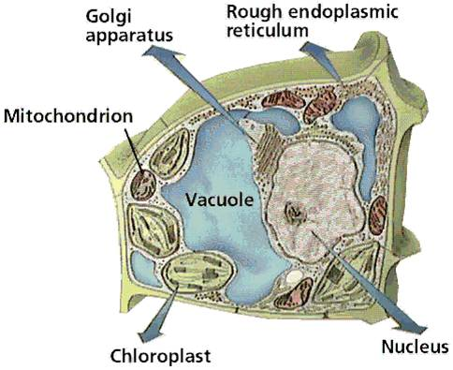
Plant Cell Special Features
Cell wall – protection and support
Chloroplast - for photosynthesis
Large central vacuole-
for storage and increase surface area

Slide 14
Organelles of Microbial Origin
Mitochondria – have DNA similar to that of a Prokaryotic cell and can reproduce independent of the rest of the Eukaryotic cell.
Chloroplasts – also have DNA similar to that of a Prokaryotic cell and can reproduce independent of the rest of the Eukaryotic cell.
It is believed that both chloroplasts and mitochondria were one independent Prokaryotes who took up residence in the Eukaryotic cell and have developed a special symbiotic relationship

Slide 15
MICROBIAL GROWTH CURVE

Slide 16
BENEFICIAL VS HARMFUL MICROBES
Over 99% contribute to the quality of human life
Live in every environment on earth
Important in ecological systems
Important in biogeochemical cycles
Human digestion depends upon them
Important to the food industry and the productions of many products
Help with wastewater and oil spill cleanup
Small minority cause disease

Slide 17
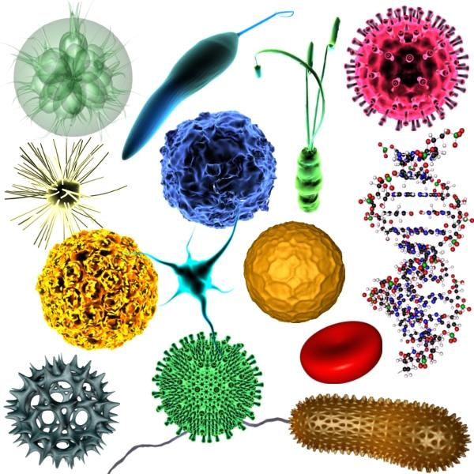
MAJOR GROUPS OF MICROBES
Prions
Viruses
Archaea
Bacteria
Algae
Protozoa
Fungi

Slide 18
PRIONS
proteinaceous infectious particles, associated with a number of diseases
characterized by loss of motor control, dementia, paralysis, wasting and eventually death
Mad Cow Disease in cattle
Creutzfeld-Jacob disease (CJD) in humans

Slide 19
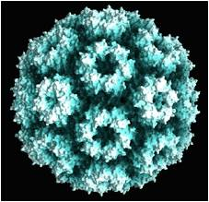
VIRUSES
Are acellular
Consists of a piece of nucleic acid (DNA or RNA) encased in protein and in some cases a membrane-like envelope
They come in many shapes
Found anywhere there are cells to infest
Exist to reproduce – must take over a suitable host cell
Uses the cell machinery of the host cell to reproduce

Slide 20
Archaea
Similar to bacteria – prokaryotic
Cell walls lack peptidoglycan + other differences
Origin very old - during formation of the earth
Extremely tolerant to heat, acid, and toxic gases
Found in extreme habitats in anaerobic environments to produce methane, high salt concentrations or hot acid environments
Involved in carbon & nitrogen cycles, assist in digestion, & can be used in sewage treatment

Slide 21
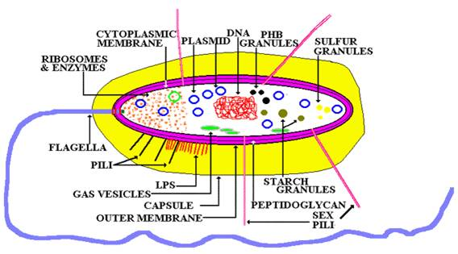
Bacteria
Only one cell – a prokaryotic cell
Live in all environments – even above boiling point and below freezing point
Basically three shapes – spherical , rod , and spiral or helical (spirullum) Exist as individuals or cluster together to form pairs, chains, squares, or other groupings
Some form spores
Some are photoautotrophic - make their own food as plants and give off oxygen – Cyanobacteria are also aerobic Purple and green bacteria are anaerobic
Some are chemoautotrophic - synthesize their own food using energy from chemical reactions – important for recycling in nitrogen and sulfur cycles
Some have flagella - rotates like a tiny outboard motor, others
secrete a slime layer and move over surfaces like slugs

Slide 22
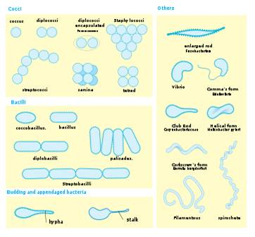
BACTERIAL SHAPES

Slide 23
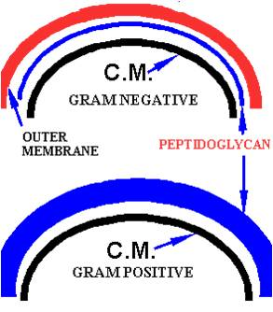
GRAM + VS. GRAM – BACTERIA
Gram positive bacteria
stain purple under Gram stain
have a thick bilayer wall of the polymer peptidoglycan.
Gram negative bacteria
stain red
have a thin layer of this polymer and an additional lipopolysaccharide outer layer, LPS,
often endotoxic - capable of initiating inflammation and cell-mediated immune responses
e.g., Salmonella, Shigella, and Escherichia.

Slide 24
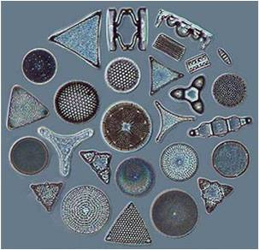
Algal Protists (ALGAE)
Are Eukaryotic
Found in fresh and salt water environments
Can live on rocks, trees, and in soils with enough moisture
Can carry on photosynthesis – produce large amount of oxygen
Diatoms, Clamydomonas, Volvox, Spirogyra

Slide 25
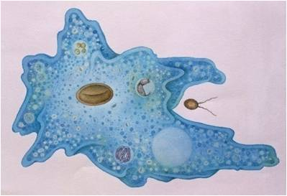
Animal-like Protists (PROTOZOA)
Protozoa means “little animal” – act like tiny animals – Eukaryotic
Hunt other microbes for food
Mainly feed on bacteria, also other protozoa and some algae
Digest food in digestive organelles
Ciliates, Amoebaes, Flagellates - Paramecium, Amoeba, Euglena
Most are not harmful – a few are harmful
Certain protozoa can cause dysentery and malaria

Slide 26
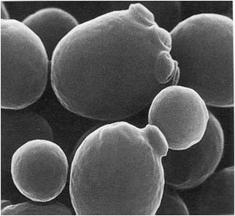
Fungi
Cellular level, more like animals than plants – Eukaryotic
Can’t synthesize their own food
Single celled as yeast or multicellular clusters as molds & mushrooms
Multicellular ones form filament like strands – hyphae
Grow best in slightly acidic environment – can grow in low moisture
Live in soil, on plants & animals, in fresh & salt water
One teaspoon of topsoil has about 120,000 fungi
Baker’s yeast for bread and brewing, some are used for antibiotics, others serve as decomposers
Some cause disease in humans, animals and plants – ruin ¼ to ½ of fruits & vegetables per year

Slide 27
MICROBES AND ECOLOGY
Major producers in aquatic environments
Decomposers – bacteria and fungi – in many ecosystems
Key role in Biogeochemical cycles to recycle carbon, nitrogen, carbon, water
Natural pest killers in gardens and on crops
Breakdown oil from oil spills
Serve as natural water treatment
Can cause some ecological problems as red tide and algal blooms

Slide 28
Wastewater Microbiology
Microbes play a key role in water and waste treatment facilities
Are involved in natural waterways
Involved in maintaining septic tanks
Coliform bacteria as E. coli can contaminate water making it unsafe

Slide 29
MICROBES AND FOOD
Milk into yogurt, buttermilk, sour cream, cheese
Aid in production of chocolate, bread products, wine, beer, tea
Pickling process to make pickles from cucumbers and sauerkraut from cabbage

Slide 30
Fermentation Products and their Uses
Carbon dioxide – bread making
using baker’s yeast
Alcohol – wine making and brewing using yeast
Lactic Acid – lactic acid bacteria ferment milk into products as yogurt

Slide 31
Food Spoilage and Food Decomposition
Microbes play a key role – bacteria and fungi – in food spoilage and decomposition
Many types can live at low temperatures as mold on food in the refrigerator
Food preservation techniques as salt and high acid affect microbes

Slide 32
MICROBES AND INDUSTRY
Microbes (fungi and bacteria) are used to make antibiotics
Algae are being used to make petroleum
Yeast and bacteria are used in producing medicines

Slide 33
Microbes and Diseases
There are many agents of infectious diseases
Microbes acting as agents are prions, viruses, bacteria, fungi, protozoa, parasitic worms
Examples of common diseases for each to follow

Slide 34
List of Microbial Diseases
Be sure to check the
SO National website
for the final 2018 List
of Diseases.

Slide 35
VIRAL DISEASES
AIDS
Chicken Pox & Shingles
Common Cold
Dengue Fever
Ebola Hemorrhagic Fever
Hepatitis
Influenza
Measles
Mumps
Mononucleosis
Polio
Rabies
Rubella
Small pox
West Nile Fever
Yellow Fever

Slide 36
BACTERIAL DISEASES
Anthrax
Botulism
Chlamydiasis
Cholera
Dental Caries (tooth decay)
Legionnaire's Disease
Lyme Disease
MRSA
Peptic Ulcer Disease
Pertussis (whooping cough)
Rocky Mountain Spotted Fever
Strep throat
Syphilis
Tetanus
Tuberculosis

Slide 37
FUNGAL DISEASES
Athlete’s foot
Dutch Elm Disease
Ergotism
Histoplasmosis
Potato Blight
Ringworm
Thrush

Slide 38
PROTOZOAN/ALGAL DISEASES
Malaria
Paralytic Shellfish Poisoning
Estuary Associated Syndrome
Giradiasis
Cryptosporidiosis

Slide 39
PRION DISEASE
Scrapie
Kuru

Slide 40
PARASITIC WORMS
Hookworm
Pinworm
Schistosomiasis
Tapeworm
Trichinosis

Slide 41
National Tournament
Added Diseases Topics:
Important Genera Related to Disease

Slide 42
IMPORTANT GENERA
Wolbachia
Batrachochytrium

