Slide 1
2015 Anatomy & Physiology (B & C)
Karen Lancour Patty Palmietto
National Bio Rules National Event
Committee Chairman Supervisor – A&P

Slide 2
Event Rules – 2015
DISCLAIMER
This presentation was prepared using draft rules. There may be some changes in the final copy of the rules. The rules which will be in your Coaches Manual and Student Manuals will be the official rules.

Slide 3
Event Rules – 2015
BE SURE TO CHECK THE 2015 EVENT RULES FOR EVENT PARAMETERS AND TOPICS FOR EACH COMPETITION LEVEL

Slide 4
ANATOMY & PHYSIOLOGY
Event Content: 2015
BASIC ANATOMY AND PHYSIOLOGY
Cardiovascular system(new for B&C)
Integumentary system
Immune system (new for B)
Major disorders
Treatment and prevention of disorders
PROCESS SKILLS - observations, inferences, predictions, calculations, data analysis, and conclusions.

Slide 5
TRAINING MATERIALS
Training Power Point – content overview
Training Handout - content information
Sample Tournament – sample problems with key
Event Supervisor Guide – prep tips, event needs, and scoring tips
Internet Resource & Training CD’s – on the Science Olympiad website at www.soinc.org under Event Information
Biology-Earth Science CD, Anatomy/A&P CD (updated) as well as the Division B and Division C Test Packets are available from SO store at www.soinc.org

Slide 6
CARDIOVASCULAR SYSTEM
Karen Lancour Patty Palmietto
National Bio Rules National Event
Committee Chairman Supervisor – Health
karenlancour@charter.net Science

Slide 7
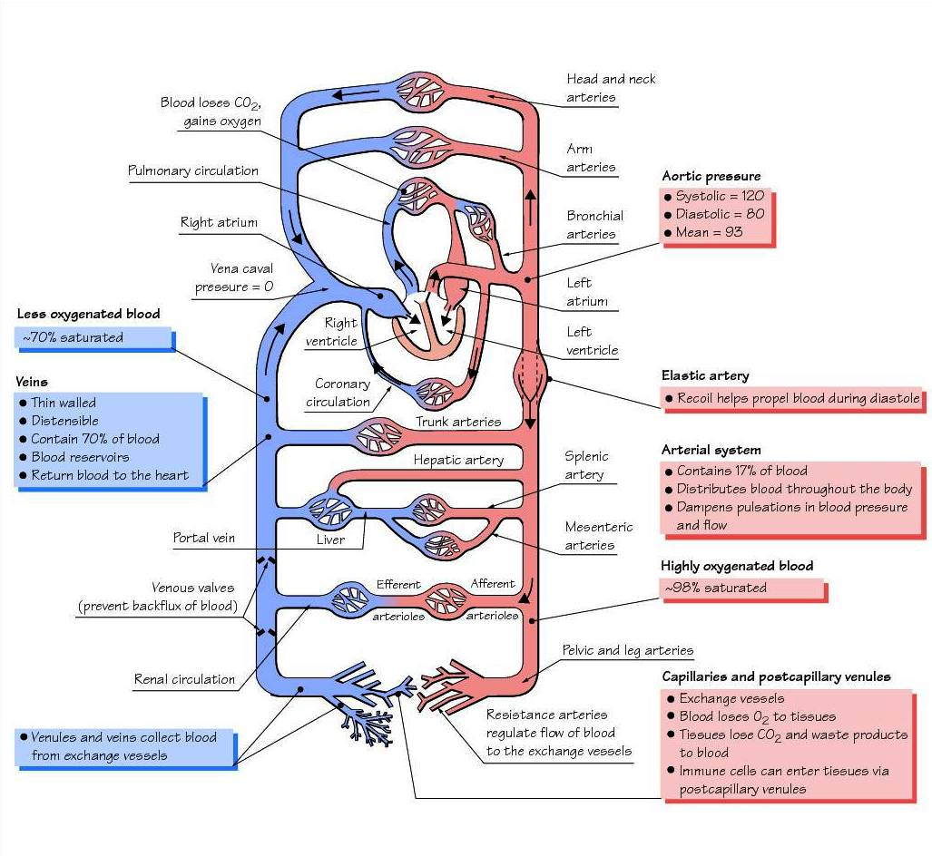

Slide 8
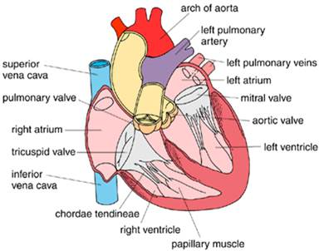
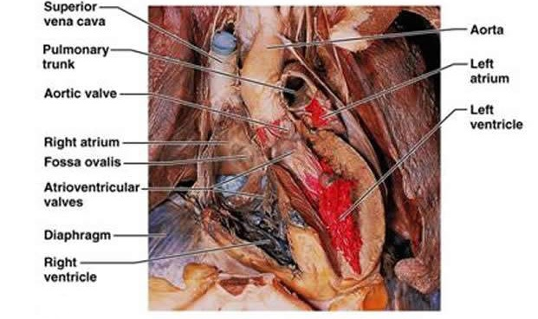
Heart/Circulatory

Slide 9
Blood Flow through the Heart

Slide 10
Electrical System of Heart
1. Sinoatrial Node (SA Node)-Pacemaker of the heart
2. Intra-atrial Pathway-carries electricity through atria
3. Internodal Pathway-carries electricity through atria
4. Atriaventricular Node (AV Node)-Back up pacemaker. Slows conduction
5. Bundle of His-last part of conduction in atria
6. Right Bundle Branch-carry electricity through R. Ventricle
7. Purkinje Fibers-distribute electrical energy to the myocardium
8. Left Bundle Branch-carries electricity through L. Ventricle

Slide 11
Electrocardiogram
Electrocardiogram (ECG or EKG) = record of spread of electrical activity through the heart
P wave = caused by atrial depolarization (contraction)
QRS complex = caused by ventricular depolarization (contraction) and atrial relaxation
T wave = caused by ventricular repolarization (relaxation)
ECG = useful in diagnosing abnormal heart rates, arrhythmias, & damage of heart muscle

Slide 12
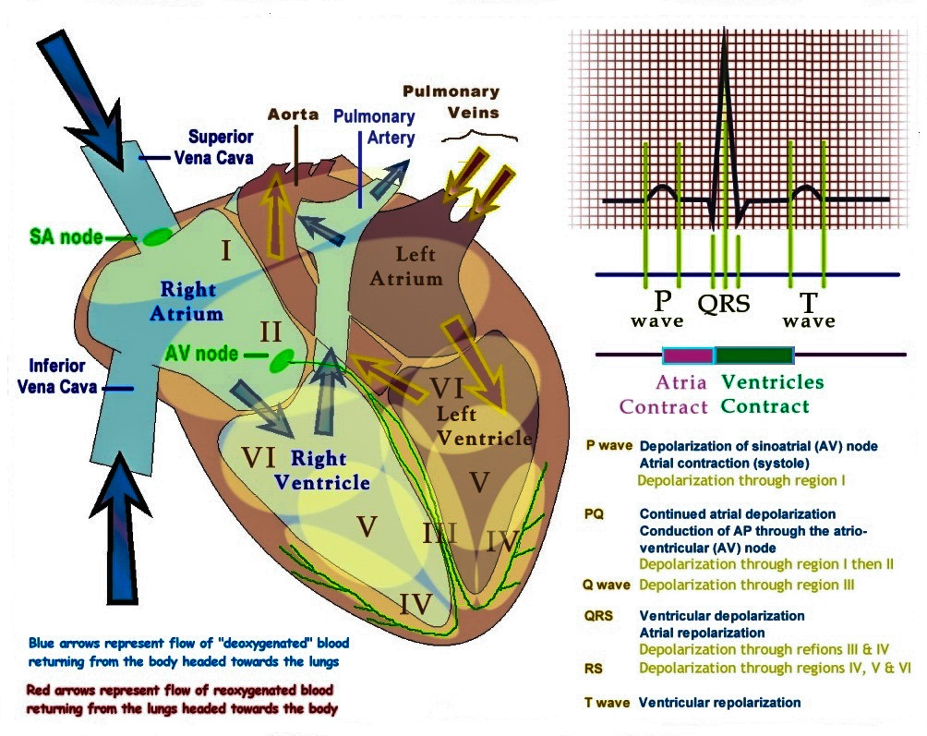

Slide 13
Cardiac Cycle

Slide 14
Circulatory System Relevant formulas
Stroke volume (SV) = milliliters of blood pumped per beat
Heart rate (HR) = number of beats per minute
Cardiac output (CO) = heart rate times stroke volume
CO = HR x SV
Pulse pressure (PP) = the difference between systolic pressure (SP) and diastolic pressure (DP)
PP = SP – DP
Mean Arterial Pressure (MAP) (2 equations):
Formula 1: MAP = diastolic pressure + 1/3 pulse pressure
Formula 2: MAP = 2/3 diastolic pressure + 1/3 systolic pressure

Slide 15
Flow of Blood Through the Body
vena cava → right atrium → tricuspid valve → right ventricle → pulmonary valve → pulmonary artery → pulmonary capillary bed→ pulmonary veins →left atrium → bicuspid (mitral valve) →
left ventricle → aortic valve→ aorta→ arteries→ arterioles → tissue capillaries → venules → veins → vena cava

Slide 16
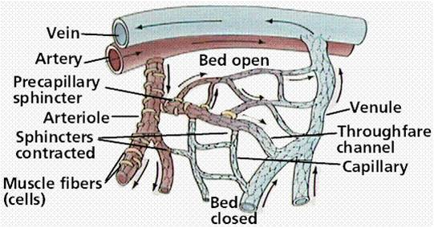
Blood Vessels
Arteries
Arterioles
Veins
Venules
Capillaries

Slide 17
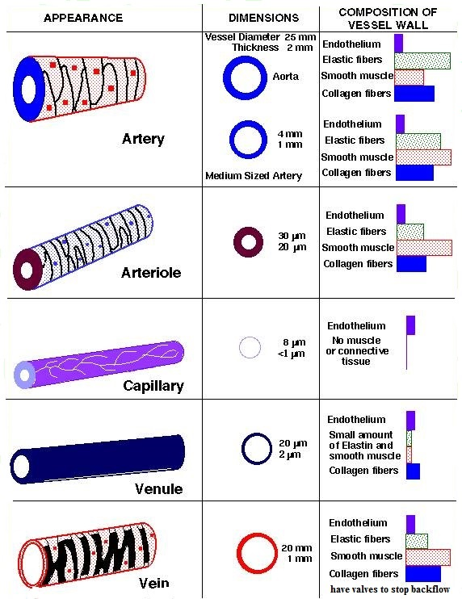

Slide 18
Functions of Blood
Transportation:
oxygen & carbon dioxide
nutrients
waste products (metabolic wastes, excessive water, & ions)
Regulation - hormones & heat (to regulate body temperature)
Protection - clotting mechanism protects against blood loss & leucocytes provide immunity against many disease-causing agents

Slide 19
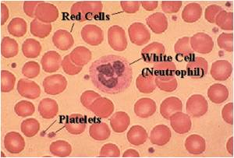
Blood Components
Formed elements:
Red blood cells (or erythrocytes)
White blood cells (or leucocytes)
Platelets (or thrombocytes)
Plasma = water plus
dissolved
solutes

Slide 20
Lymph Vessels
Lymph vessels are thin walled, valved structures that carry lymph
Lymph is not under pressure and is propelled in a passive fashion
Fluid that leaks from the vascular system is returned to general circulation via lymphatic vessels.
Lymph vessels act as a reservoir for plasma and other substances including cells that leaked from the vascular system

Slide 21
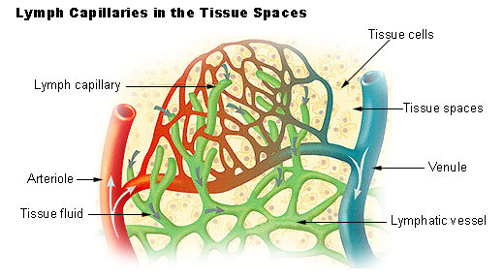
Lymph Circulation
Interstitial fluid → Lymph → Lymph capillary → Afferent lymph vessel → Lymph node → Efferent lymph vessel → Lymph trunk → Lymph duct {Right lymphatic duct and Thoracic duct (left side)} → Subclavian vein (right and left) → Blood → Interstitial fluid...

Slide 22
Effects of Exercise
Decreases the risk of atherosclerosis
Decreases BP or causes a slower rise in BP
Decreases LDLs, decreases cholesterol, and increases HDLs

Slide 23
Major diseases of the Cardiovascular System
Arteriosclerosis, atherosclerosis, high blood pressure, high cholesterol, stroke, and myocardial infarction, congestive heart failure, atrial fibrillation, bradycardia, tachycardia
Symptoms of disorders
Treatments and prevention

Slide 24
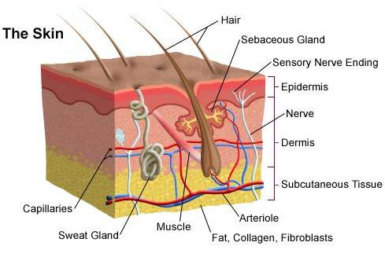
Integumentary System
The integumentary system consists of the skin, hair, nails, the subcutaneous tissue below the skin, and assorted glands

Slide 25
Skin Functions
Protection from injury
Protection against infection
Regulates body temperature
Regulates water loss
Chemical synthesis
Sensory perception

Slide 26
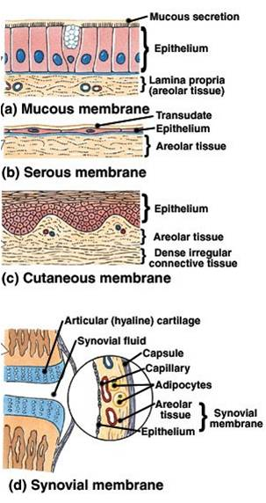
Types of Membranes
Serous Membranes
Line body cavities that have no opening to the outside
Secrete a watery fluid called serous fluid that lubricates surfaces
Mucous Membranes
Line cavities and tubes that open to the outside
Synovial Membranes
Form the inner lining of joint cavities
Secrete a thick fluid called synovial fluid
Cutaneous Membrane – also
known as skin

Slide 27
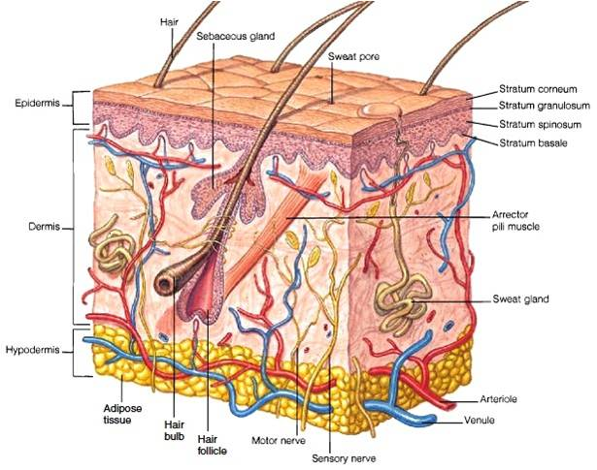
Skin Layers and Attachment Layer
Epidermis
Covers internal + external surfaces of body
Dermis
Inner layer – Contains
accessory skin structures
Hypodermis or subcutaneous layer
Attaches the skin to underlying organs & tissues

Slide 28
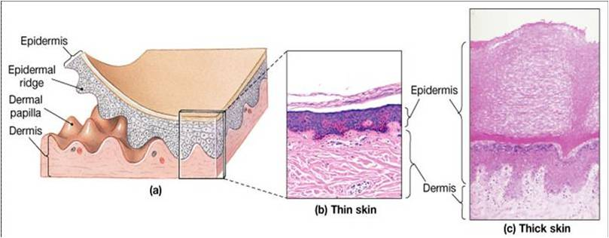
Thin skin vs. Thick skin
Thin - 1-2 mm on most of the body and 0.5 mm in eyelids – Hairy; Covers all parts of the body except palms, soles
Thick - up to 6 mm thick on palms of hands and soles of feet; Hairless; Covers palms, and soles

Slide 29
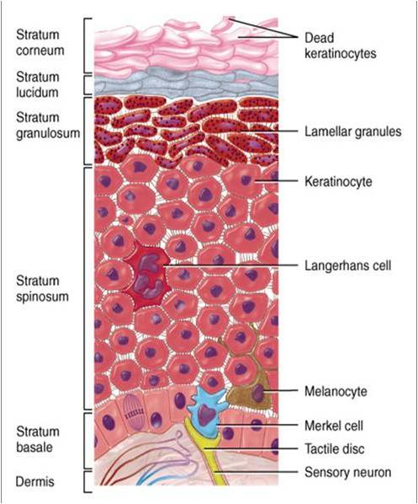
Epidermal Cell Types
Keratinocytes - 90 % of epidermal cells are keratinized contains keratin (fibrous protein) protects and waterproofs the skin
Melanocytes - 8% of the epidermal cells produces melanin contributes to skin color and absorbs UV light
Langerhans cells - Arise from red bone marrow and migrate to the epidermis -Constitute small portion of epidermal cells -Participate in immune responses Easily damaged by UV light
Merkel cells - Least numerous of the epidermal cells Found in the deepest layer of the epidermis-Along with tactile discs, they function in sensation of touch

Slide 30
Epidermal Layers
Stratum corneum - nuclei and organelles are destroyed by lysosomes and the cells fill with keratin
Stratum lucidum - only found in the palms and soles of feet 3-5 layers of clear, flat, dead keratinocytes -Dense packed intermediate filaments Thick plasma membranes
Stratum granulosum - cells start to become keritanized --Secretes lipid-rich secretion that acts as a water sealant
Stratum spinosum - 8-10 layers of keratinocytes
skin both strength and flexibility
Stratum basale - Also referred to as stratum germinatum -where new cells are formed -

Slide 31
Growth of Epidermis
Newly formed cells in the stratum basale undergo keratinazation as they are pushed to the surface and accumulate more keratin during the process
Then they undergo apoptosis or death
Eventually they slough off and are replaced
The process takes about 4 weeks
Rate of cell division in the stratum basale increases during injury

Slide 32
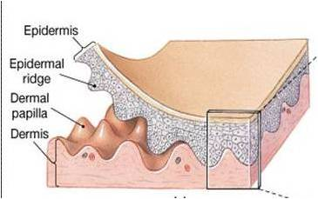
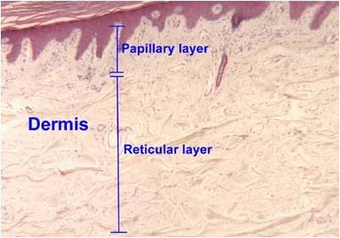
Dermis
Second deepest part of the skin
Composed mainly of connective tissues (collagen and elastic fibers)
Papillary Layer – Surface area is increased due to projections called dermal papillae which contains capillaries or tactile receptors -Epidermal ridges conforms to the dermal papillae
Reticular Layer -Contains hair follicles, nerves, sebaceous and sudoriferous glands

Slide 33
Hypodermis
(Subcutaneous) Attaches the skin to underlying organs and tissues
Not part of the skin - lies below the dermis
Contains connective tissue and adipose tissues (subcutaneous fat) for insulation
Infants and elderly have less of this than adults and are therefore more sensitive to cold

Slide 34
Skin Color

Slide 35
Skin Color
Genetic Factors – Skin pigmentation
All humans have the same number of melanocytes
How much melanin they produce is controlled by several genes
Lack of pigment is called albinism
Environmental Factors - Exposure to sunlight
Volume of Blood – Hemoglobin in blood

Slide 36
Skin Pigments – Melanin
Located mostly in epidermis
Two types of melanin: eumelanin which is brownish black and pheomelanin which is reddish yellow
Fair-skinned people have more pheomelanin and dark skinned people have more eumelanin

Slide 37
Environmental Factors Affect Melanin Production
UV light increases enzyme activity in melansomes – increased melanin production
A tan = amount of melanin increases + darkness of melanin
Eumelanin = protection from UV radiation but pheomelin breaks down with too much UV
Too much UV radiation may cause skin cancer

Slide 38
Other Skin Pigments
Carotene = yellow -orange pigment
precurser of Vitamin A – important for vision
Found in Stratum corneum and fatty areas of dermis and hypodermal layer
Hemoblobin = oxygen carrying pigment in red blood cells

Slide 39
Skin Markings
friction ridges: markings on fingertips characteristic of primates - allow us to manipulate objects more easily-fingerprints are friction ridge skin impressions
flexion lines: on flexor surfaces of digits, palms, wrists, elbows etc.- skin is tightly bound to deep fascia at these points
freckles: flat melanized patches vary with heredity or exposure to sun
moles: elevated patch of melanized skin, of the with hair mostly harmless, beauty marks

Slide 40
Aging Skin
In our 20s, the effects of aging begin to be visible in the skin.
Stem cell activity declines: skin thin, repair difficult
Epidermal dendritic cells decrease: reduced immune response
Vitamin D3 production declines: calcium absorption declines and brittle bones
Glandular activity declines: skin dries, body can overheat
Blood supply to dermis declines: tend to feel cold
Hair follicles die or produce thinner hair
Dermis thins and becomes less elastic – wrinkles

Slide 41
Skin Derivatives
During embryonic development thousands of small groups of epidermal cells from stratum basale push down into dermis to form hair follicles and glands

Slide 42
Functions – Hair & Nails
Functions of Hair
Hair on the head protects scalp from injury and sunlight
Eyelashes and eyebrows protect eyes
Nostril and ear hairs protect from foreign particles
Help in sensing light touch due to the touch receptors associated with the hair root plexuses.
Functions of the Nails
Grasping objects
Manipulating objects
Protects ends of digits from trauma
Scratching

Slide 43
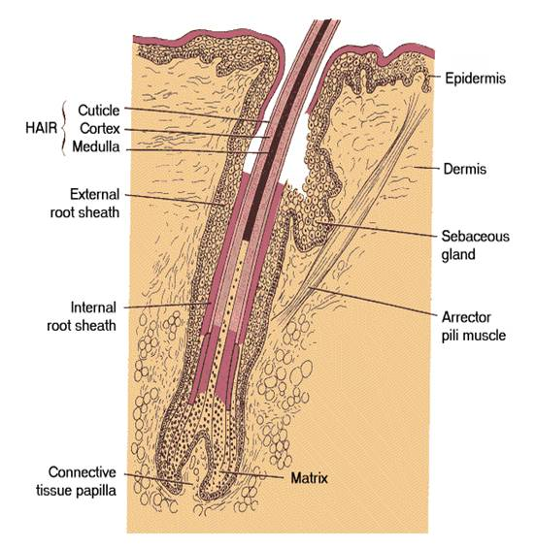
Hair Anatomy
Shaft: portion of hair that projects from skin surface
Root: portion of hair deep to the shaft penetrating the dermis
Has 3 layers:
medulla
cortex
cuticle
Base of the hair follicle
Bulb: houses the papilla which contains the blood vessels that nourishes the growing hair follicle.
Matrix: responsible for hair growth and produces new hair
Arrector pili: smooth muscle
Extends from the dermis to the side of hair follicle.
Hair root plexus - dendrites of neurons which are sensitive to touch

Slide 44
Hair Features & Texture
About 100,000 hairs are on the scalp
Almost every part of body is covered with hair except palms of hands, soles of feet, sides of fingers and toes, lips and parts of genitals
Hair shafts differ in size, shape, and color. In the eyebrows they are short and stiff while on the scalp they are longer and more flexible. Over the rest of the body they are fine and nearly invisible
Oval shaped hair shafts produce wavy hair,
Flat or ribbon-like hair shafts produce curly or kinky
hair
Round hair shafts produce straight hair.
Roughly 5 million hairs cover the body of an average individual

Slide 45
Hair Growth
Hair follicles grow in repeated cycles.
One cycle can be broken down into three phases.
Anagen - Growth Phase
Catagen – Transitional Phase
Telogen - Resting Phase
Each hair passes through the phases independent of the neighboring hairs

Slide 46
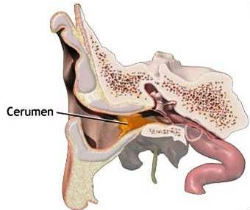
Skin Glands
Sudoriferous - sweat glands
Eccrine sweat glands -Secretes cooling sweat
Appocrine sweat glands - during emotional stress/excitement
Sebaceous - oil glands –
Acne - inflammation of sebaceous gland ducts
Ceruminous - modified sweat glands of the external ear that produce ear wax

Slide 47
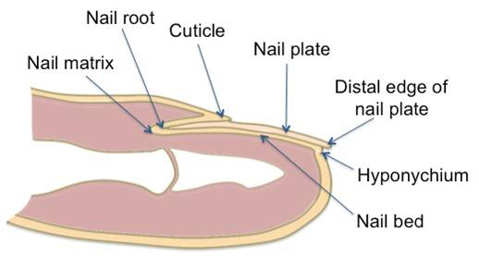
Nails
Made of tightly packed, hard, keratinized epidermal cells
Consist of:
Nail body: portion of the nail that is visible- Free edge: part that extends past the distal end of the digit
Nail root: portion buried in a fold of skin
Lunula: means little moon - Crescent shaped area of the nail
Hyponychium: secures the nail to the fingertip -Thickened stratum corneum
Eponychium or cuticle: narrow band of epidermis-Growth of nails is in the nail matrix.

Slide 48
Skin Receptors
Heat
Cold
Light pressure
Heavy Pressure
Pain

Slide 49
Skin Imbalances
Skin Leisons
Skin Infections
Viral as cold sores, herpes simplex, warts (HPV)
Bacterial as bioles, carbuncles, inflammmation of hair follicles and subaceous glands. Impetigo
Fungal as athletes food, Tinea
Contact Dermatitis
Irritant Dermatitis as soaps, detergents, shampoo
Allergic Dermatitis as poison ivy, poison oak, rubber gloves, nickel and other medals, fragrances

Slide 50
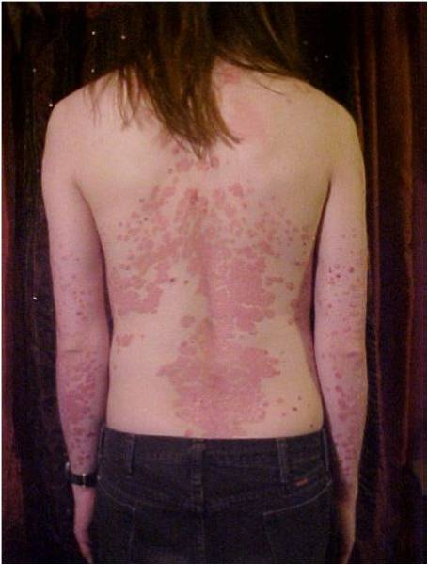
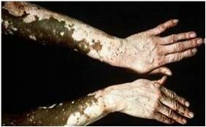
Genetic Disorders
Psoriasis
chronic, noninfectious skin disease
skin becomes dry and scaly, often with pustules and many varieties
stratum corneum gets thick as dead cells accumulate
often triggered by trauma, infection , hormonal changes or stress
Vitiligo – a autoimmune pigmentation disorder where melanocytes in the epidermis are destroyed eg Michael Jackson

Slide 51
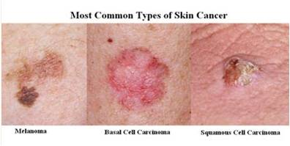
Skin cancer

Slide 52
Types of Skin Cancer
Basal Cell Carcinoma
Spread uncommon, very curable if found early
Squamous Cell Carcinoma
Occurs parts exposed to the sun

Slide 53
Types of Skin Cancer (cont.)
Malignant Melanoma
Most common in southern hemisphere where the ozone layer is thin.
Deadly if not caught early!!

Slide 54
Skin Cancer
Very common
ABCD
Asymmetry
Borders
Color
Diameter

Slide 55
Skin Cancer Prevention
Use SPF 15 minimum.
Wear hats and shirts with sleeves.
Wear sunglasses to protect eyes from UV.
Avoid tanning beds

Slide 56
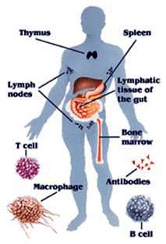
Immune System Components
specific cells - lymphocytes, macrophages, etc., originate from precursor cells in the bone marrow and patrol tissues by circulating in either the blood or lymphatics, migrating into connective tissue or collecting in immune organs
lymphatic organs- thymus, spleen, tonsils, lymph nodes
diffuse lymphatic tissue -collections of lymphocytes and other immune cells dispersed in the lining of the digestive and respiratory tracts and in the skin

Slide 57
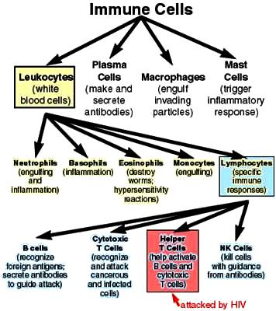
Types of Cells

Slide 58
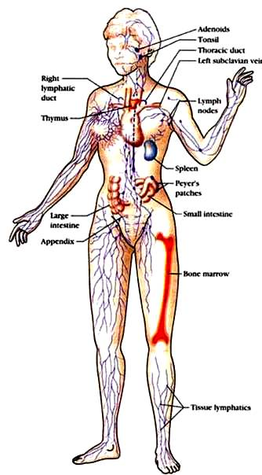
Lymphmatic Organs
Lymph Nodes
Spleen
Thymus
Red Bone Marrow
Immune Tissue in Organs – GALT, MALT, SALT

Slide 59
Plan of Protection
Immunity is the ability to defend against infectious agents, foreign cells and abnormal cells eg. cancerous cells
1st Line of defense – Block entry
2nd Line of Defense – Fight Local Infections
3rd Line of Defense – Combat Major Infections

Slide 60
Nonspecific Response
Responds quickly, fights all invaders and consists of:
First line of defense – intact skin and mucosae and secretions of skin and mucous membranes prevent entry of microorganisms
Second line of defense – phagocytic white blood cells, antimicrobial proteins, and other cells
Inflammatory response process is key
Inhibit invaders from spreading throughout the body

Slide 61
First line of Defense
Non specific barriers to block entry
Skin – physical & chemical barrier
Mucous membranes
Nasal hairs and microscopic cilia
Gastric juice, vaginal secretions & urine
Natural flora
Tears, saliva and sweat glands
Cerumen or Ear Wax

Slide 62
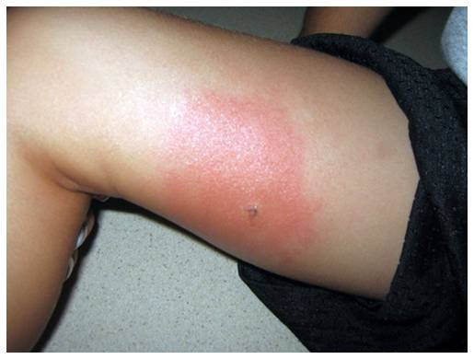
Second Line of Defense
Fight local infection with Inflammation Process
Response is a non-specific, immediate, maximal response
Consists of phagocytosis, complement protein response
Involve the Inflammation Process

Slide 63
Phagocytes and Their Relatives

Slide 64
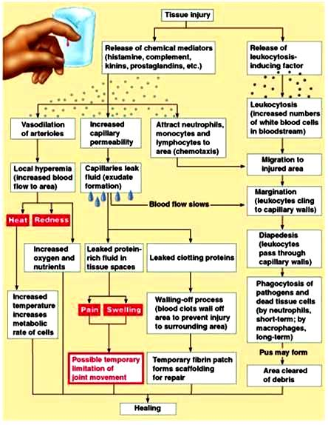
Inflammation Process

Slide 65
Specific Response
Third Line of Defense
takes longer to react
work on specific types of invaders- identifies and targets for destruction
not restricted to initial site of invasion/infection – whole body protection
a stronger immune response as well as immunological memory

Slide 66
Antigens
Antigens are proteins or carbohydrate chain of a glycoprotein within a plasma membrane which the body recognizes as “nonself”
antigen presentation - specific immune response is antigen-specific and requires the recognition of specific “non-self” antigens

Slide 67
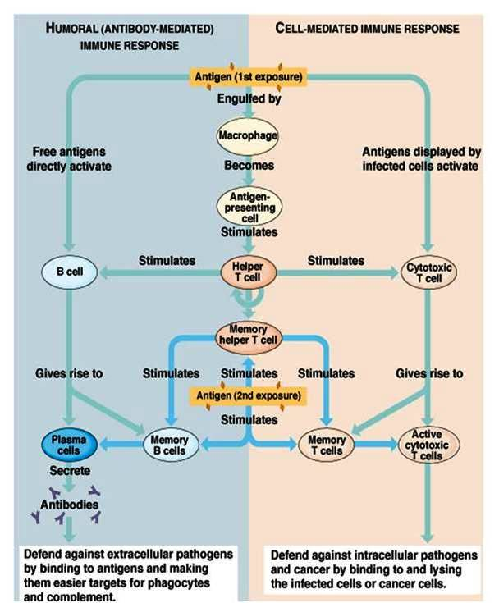
Specific Defense

Slide 68
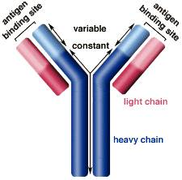
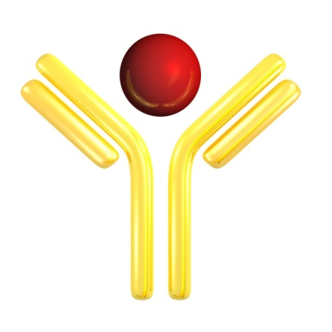
Humorial – Antibody (Extracellular Response)
B cells
Plasma Cells -produce antibodies
Antibody-antigen Complex
Helper T Cells
Memory Cells

Slide 69
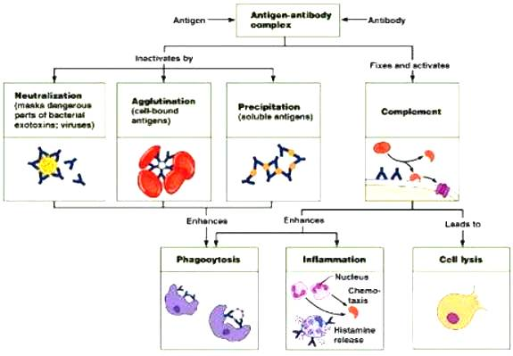
Antigen-Antibody Complex Functions

Slide 70
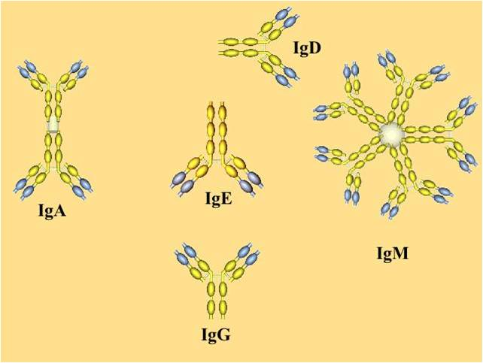
Classes of Antibodies

Slide 71
Classes of Antibodies
IgA | Antibodies are dimmers – contain two Y shaped structures. Found in mucosal areas, such as the gut, respiratory tract and urogenital tract. Also found in saliva, tears, and breast milk. They attack microbes and prevents colonization by pathogens before they reach the blood stream so it is most important antibody in local immunity
IgD | Functions mainly as an antigen receptor on B cells that have not been exposed to antigens. It has been shown to activate basophils and mast cells to produce antimicrobial factors.
IgG | In its four forms, provides the majority of antibody-based immunity against invading pathogens. It makes up about 75 % of all human antibodies and is the body’s major defense against bacteria. The only antibody capable of crossing the placenta to give passive immunity to fetus. It is the most versatile of antibodies because it carries out functions of the other antibodies as well.
IgE | Binds to allergens and triggers histamine release from mast cells and basophils, and is involved in allergy. Also protects against parasitic worms.
IgM | Expressed on the surface of B cells and in a secreted form with very high avidity. Eliminates pathogens in the early stages of B cell mediated (humoral) immunity before there is sufficient IgG.

Slide 72
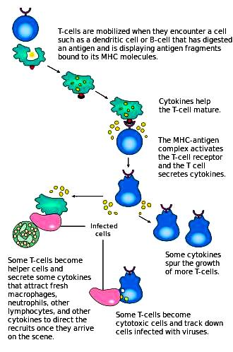
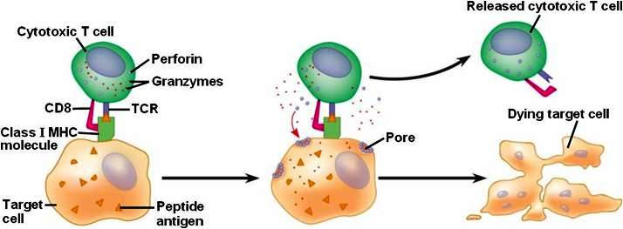
Cell-mediated immune response
Within the cell
involves the activation of phagocytes, antigen-specific cytotoxic T-lymphocytes, and the release of various cytokines in response to an antigen

Slide 73
Memory B & T Cells
Should a pathogen infect the body more than once, these specific memory cells are used to quickly eliminate

Slide 74
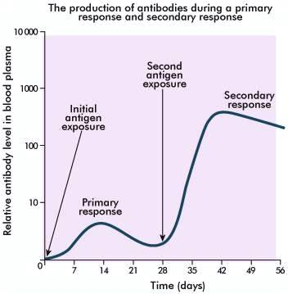
Primary & Secondary Immunity

Slide 75
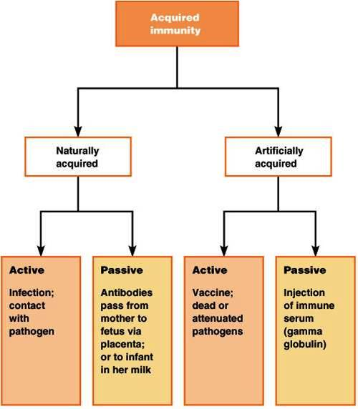
Sources of Specific Immunity Inborn & Acquired
Inborn Immunity – Immunity for certain diseases is inherited
Acquired Immunity – immunity can be acquired through infection or artificially by medical intervention

Slide 76
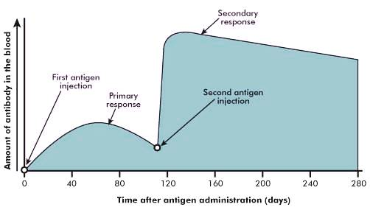
Immunization

Slide 77
Antibiotics and Antivirals
Antibiotics or antibacterials – group of medications used to kill bacteria by preventing them from dividing
There is concern about the extensive use of antibiotics resulting in resistant forms of bacteria and “superbugs”
Antivirals – group of medications used to treat viral infections but they cannot destroy the virus. Rather they inhibit the virus from reproducing and developing.

Slide 78
Cultured Antibodies
Monoclonal antibodies – cloning of many copies of the same antibody which can be useful in fighting diseases because they can be designed specifically to only target a certain antigen, such as one that is found on cancer cells

Slide 79
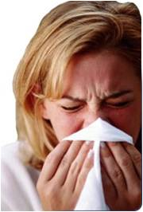
Allergies
Hypersensitivity of the immune system to relatively harmless environmental antigens - the immune system reacts to an outside substance that it normally would ignore
Allergy types (food, dust, mold, seasonal), symptoms and signs (skin rash, itching, red bumps, sneezing)

Slide 80
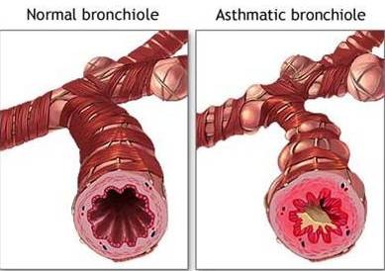
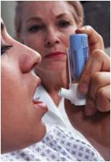
Asthma
an obstructive pulmonary disorder characterized by recurring spasms of muscles in bronchial walls accompanied by edema and mucus production which make breathing difficult
it causes the airways of the lungs to swell and narrow, leading to wheezing, shortness of breath, chest tightness, and coughing

Slide 81
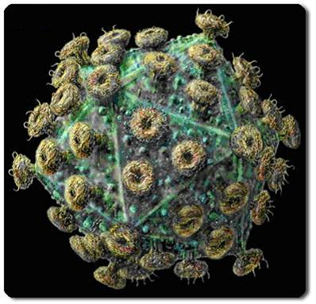
AIDS -HIV
AIDS - (acquired immune deficiency syndrome) is the final stage of HIV disease, which causes severe damage to the immune system-caused by infection with human immunodeficiency virus (HIV)- HIV infects vital cells in the human immune system such as helper T cells, macrophages, and dendrite cells

Slide 82
Autoimmune Disorders
Condition that occurs when the immune system mistakenly attacks and destroys healthy body tissue
Can't tell the difference between healthy body tissue and antigens- The result is an immune response that destroys normal body tissues
More than 80 different types – Multiple sclerosis, Rheumatoid arthritis, Systemic lupus erythematosus

Slide 83
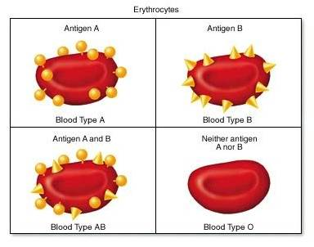
ABO Antigens
The surface membranes of RBCs carry proteins that act as antigens in some recipients
Type A blood has A antigens only.
Type B blood has B antigens only.
Type AB blood has both A and B antigens present
Type O blood lacks both A and B antigens
Blood plasma contains antibodies to the blood types not present.
Exposure to foreign blood antigens results in agglutination or clumping of RBCs, prevents circulation of blood, and the RBCs burst

Slide 84
RH Factor
Another important antigen used in matching blood types
Persons with Rh factor on RBC membrane are Rh positive; Rh negative lack the Rh factor protein.
Rh negative individuals do not automatically have antibodies to Rh factor but develop immunity when exposed to it.
Hemolytic disease of the newborn (HDN) can occur when mother is Rh negative and baby is Rh positive

