Slide 1
Food Science Notes (B)
Linda Wozniewski
lwoz@iun.edu

Slide 2
Safety
Students must wear:
  Closed shoes
  All skin from neck to toes covered
  Lab coat or lab apron
  Indirect vent or unvented chemical splash proof goggles.
  All skin from neck to wrists covered
  Long hair (shoulder length or longer) must be tied back.
  Visorgogs now permitted Students must wear:

Slide 3
What Supervisors Will Supply
Everything the student will need
  This may include:
    Glassware
    Reagents
    Balances
    Hot plates
    Thermometers
    Probes
    Magnets
    Stirrers

Slide 4
Main Focus
Chemistry of Food
How to prepare students
Experiment ideas
Resources

Slide 5
Chemistry of Food-Overview
  a. Identify the sources of and understand the role of lipids, carbohydrates and proteins typically found in baked goods, and use tests to identify these compounds, including the Benedict’s, Iodine, Biurets, and Brown Bag tests.
  b. When given samples of sweeteners, use the Benedict’s test to identify reducing sugars.
  c. When given samples of baked goods ingredients, use the Biuret test to identify and rank the ingredients by protein content.
  d. Identify common allergens in foods
  e. Determine Calories in foods from a common commercial food label.
  f. Determine the moisture loss and density of baked goods.
  g. Identify leavening agents using chemical tests, and understand the role of the leavening agents in baked goods.

Slide 6
Chemistry of Food-Overview, con’t
h. Identify GMO’s, how & why they are used in foods
i. Identify gluten and gluten free foods
j. Identify common food additives & why they are used in foods

Slide 7
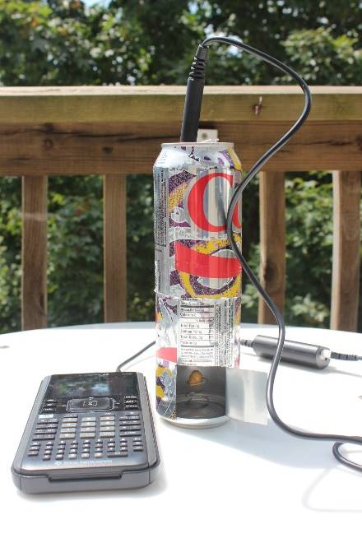
Before your event
Research! Understand the science first
Experiments
  Make a calorimeter
  Calibrate the calorimeter – multiple trials
  Experiment with the calorimeter with different foods (do this under a hood or outside)

Slide 8
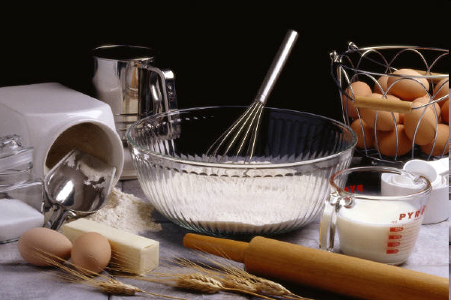
Grain Foods
Contain
  Liquids….
  Lipids
  Leavening agents
  Flours
  Sweeteners
  Additives
Must understand WHY you are using the ingredient…what function does it provide?

Slide 9
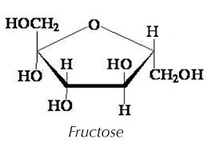
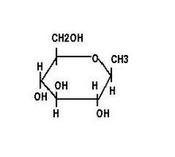
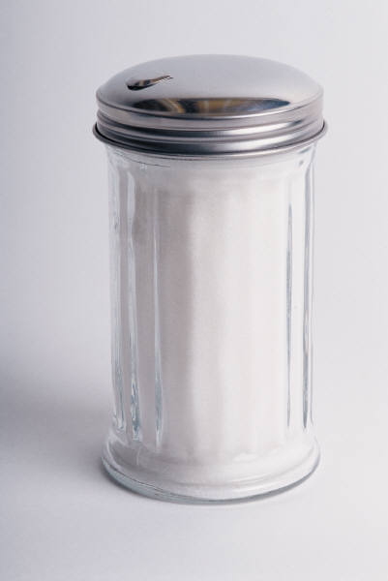
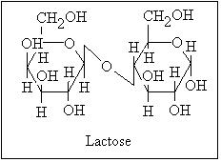
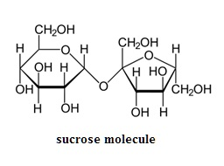
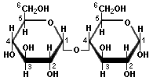
Carbohydrates-Sugars
Sugars
  Monosaccharides
    Glucose
    Fructose
  Disaccharides
    Lactose (glucose and galactose) -milk
    Maltose (glucose and glucose) -
    Sucrose (glucose and fructose –table sugar
  Reducing sugars
    Examples: glucose, lactose, fructose
  Non-reducing sugar
    Example: sucrose
  Used as:
    “liquid”-lubricant
    Flavor
    Fast energy
    Retain moisture
    Delay egg protein coagulation
    Inhibitor of gluten formation
    Regulator of gel formation
    Inhibitor of food spoilage
  When heated above its melting point, sugar carmalizes

Slide 10
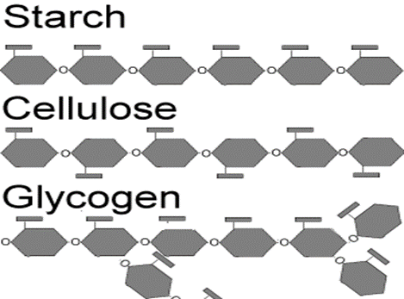
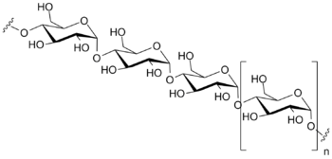
Carbohydrates-Complex
Polysaccharides
Examples:
  starch - glucose polymers, found in plants
  cellulose –found in plant fibers, insoluble
  Pectin-units are sugar acids rather than simple sugars, found in vegetables and fruits
Used to:
  Provide nutrition
  Give body to food
  Help with waste elimination
When heated, starches gelatinize-breaking molecular bonds

Slide 11
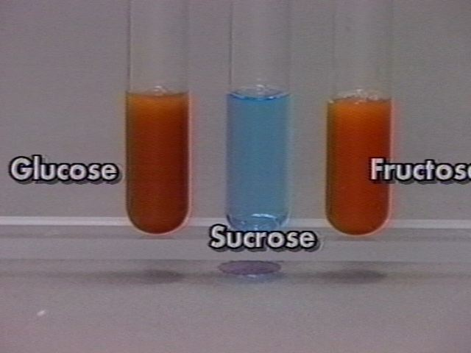
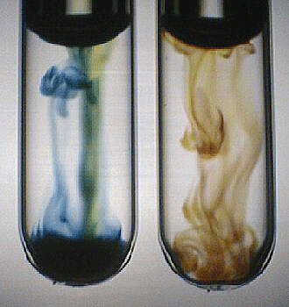
Tests for carbohydrates
Benedicts test for sugars
Iodine test for starch
Positive Reaction

Slide 12
Benedict’s Test
The Benedict's test allows us to detect the presence of reducing sugars (sugars with a free aldehyde or ketone group). All monosaccharides are reducing sugars. Some disaccharides are also reducing sugars. Other disaccharides such as sucrose are non-reducing sugars and will not react with Benedict's solution. Starches are also non-reducing sugars.
The copper sulfate (CuSO₄) present in Benedict's solution reacts with electrons from the reducing sugar to form cuprous oxide (Cu2O), a red-brown precipitate.
The final color of the solution depends on how much of this precipitate was formed, and therefore the color gives an indication of how much reducing sugar was present if a quantitative reagent was used.
With increasing amounts of reducing sugar the result will be:
green yellow orange red

Slide 13
Iodine Test
The Iodine test is used to test for the presence of starch.
Iodine solution – Iodine is dissolved in an aqueous solution of potassium iodide - reacts with starch producing a deep blue-black color.
Although the exact chemistry of the color change is not known, it is believed that the iodine changes the shape of the starch to change the color

Slide 14
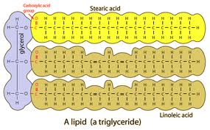
Lipids
Present as fats extracted from plants or animals (butter, vegetable oil) or as constituents of food (chocolate)
Contributions to foods: texture and flavor
Contain only Carbon, hydrogen and oxygen
Most common form for lipid in foods is as a triglyceride
What difference in texture would you see substituting vegetable shortening or vegetable oil for butter in the formulation?

Slide 15
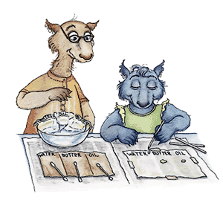
Lipids
http://www.wellsphere.com/healthy-cooking-article/butter-vs-shortening-in-baking/156136
Conversion between solid structure to a liquid state is called the melting point
How would changing the melting point of the lipid used change the cookie texture?
Brown Bag Test
Saturated fats have no double bonds in any of the fatty acid chains in the triglyceride hence it is saturated with hydrogen.
Saturated fats are usually from animals
Unsaturated fats are usually from plants
Saturated fats considered not heart healthy

Slide 16
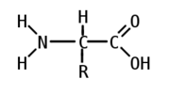
Proteins
Proteins are made up of amino acids
  essential and nonessential aa’s
  Contains Nitrogen
Protein can be found in the flour, egg and milk as well as other ingredients.
A mixture of proteins forms Gluten.
Gluten proteins are limited to the seeds of the grass family
They are prized for giving elasticity to doughs which allow breads, etc. to trap air & rise.

Slide 17
Proteins
Proteins are used to
  Provide nutrition
  Provide structure for food
  Provide texture
  Help with water retention
When cooked proteins are denatured

Slide 18
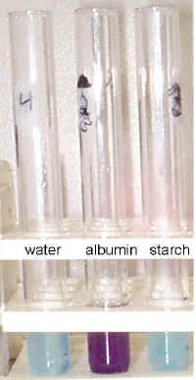
Proteins
Biuret Test
The Biuret Reagent is made of sodium hydroxide and copper sulfate. The blue reagent turns violet in the presence of proteins, and the darker the purple color, the more protein is present.
Biuret’s Reagent is unstable, but can be mixed on the spot using NaOH & Benedicts

Slide 19
Leavening agents
Used to produce a gas that 'lightens' dough or batter.
used to raise baked goods.
water a leavening agent (pie crusts, some crackers)
air incorporated into batter (angel and sponge cakes)
expand when heated and cause the raising of the dough or batter when gas is trapped in matrix of gluten and starch from flour

Slide 20

Leavening agents
Baking soda
  -NaHCO3
  Needs moisture plus an acid source such as vinegar, citrus juice, sour cream, yogurt, buttermilk, chocolate, cocoa (not Dutch-processed), honey, molasses (also brown sugar), fruits or maple syrup to react
  used to neutralize acids in foods
  around 4 times as strong as baking powder
  can cause soapy flavor in high amounts

Slide 21
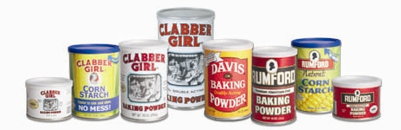
Leavening agents
Baking powder
  NaHCO3 plus acidifier(s) and drying agent (usually an acid salt and cornstarch)
  can cause acidity and/or bitter off-flavor
  two acidifiers used in double acting to produce CO2 in two steps
  Reacts when moistened and also reacts when heated
  double-acting is the only commercial baking powder available today.

Slide 22
Additives
Unless you are picking a pea right off the vine and eating it, you are eating additives
Additives are anything added to food
  So sugar, flour, salt, etc. are additives
  Some foods we eat are nothing but additives
The FDA maintains a list of over 3000 additives
All foods are chemicals
Additives are added to:
  Improve safety & freshness
  Improve/maintain nutritional value
  Improve appearance/texture/taste/etc.

Slide 23
Allergens
Top 8 food allergens must be labled (FDA)
> 50 million Americans have a food allergy
Common symptoms include
Allergies can be grown out of or into
There is lots of cross reactivity
Peanut | Tree Nut | Milk | Egg
Wheat | Soy | Fish | Crustacean Shellfish
Vomiting | Hives | Short of breath | Wheezing
Repetitive Couch | Trouble Swallowing | Weak Pulse | Pale or blue skin
Dizzy or Faint | Anaphylaxis | Hoarse throat | Stomach cramps

Slide 24
GMO-Genetically Modified Organism
Makes organisms able to withstand adverse conditions/regulate fertility/resistant to disease.
For the purposes of this event, limited to crops.
When foods are eaten, the chemicals that make up the food are both physically (teeth) and chemically (saliva and stomach HCl) broken up into small molecules (amino acids, sugar, fats), which are absorbed by the body.
The DNA of the plants does not cross into the body-just the broken up molecules.
Altering the DNA, does not change anything except the order of the nucleic acid chemicals.

Slide 25
GMO-con’t.
No way to recognize GMO foods.
They are in every way to our bodies the same as natural foods.
There is no scientific evidence that our bodies can tell the difference because by the time the chemicals cross into our bodies they are no longer in the same form they were in the original organism we ate.

Slide 26

Notebook
Notebook keeping
  All experimental data and documentation should be recorded in notebook
  Must securely hold all items
  Don’t erase in lab notebook!
  Document all references
  Use pen

Slide 27
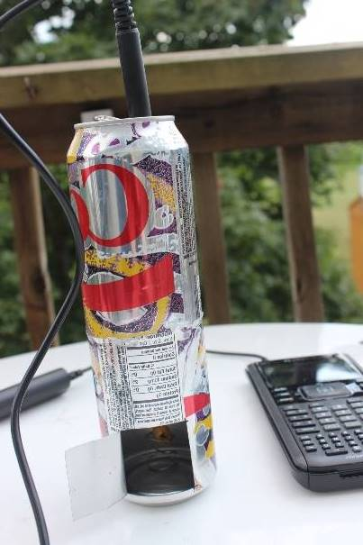
Calorimeter
Has two components
  A cup or something similar to hold water
  Something to hold the cup
Must fit in a 30 cm³ box or be penalized 10% of calorimeter score.
Does not have to be anything fancy
Must be calibrated to work

Slide 28
Calorimeter-con’t
Designed to measure the amount of heat energy in the chemicals of the food that is available to the body.
What is being burned are the fats, proteins, carbohydrates, DNA, etc. in the cells.
In our body, this burning is done in a controlled fashion to extract the energy in the bonds.
In the calorimeter it is an uncontrolled reaction.
The products of the reaction of oxygen and the food, in either the calorimeter or our body is carbon dioxide and water.

Slide 29
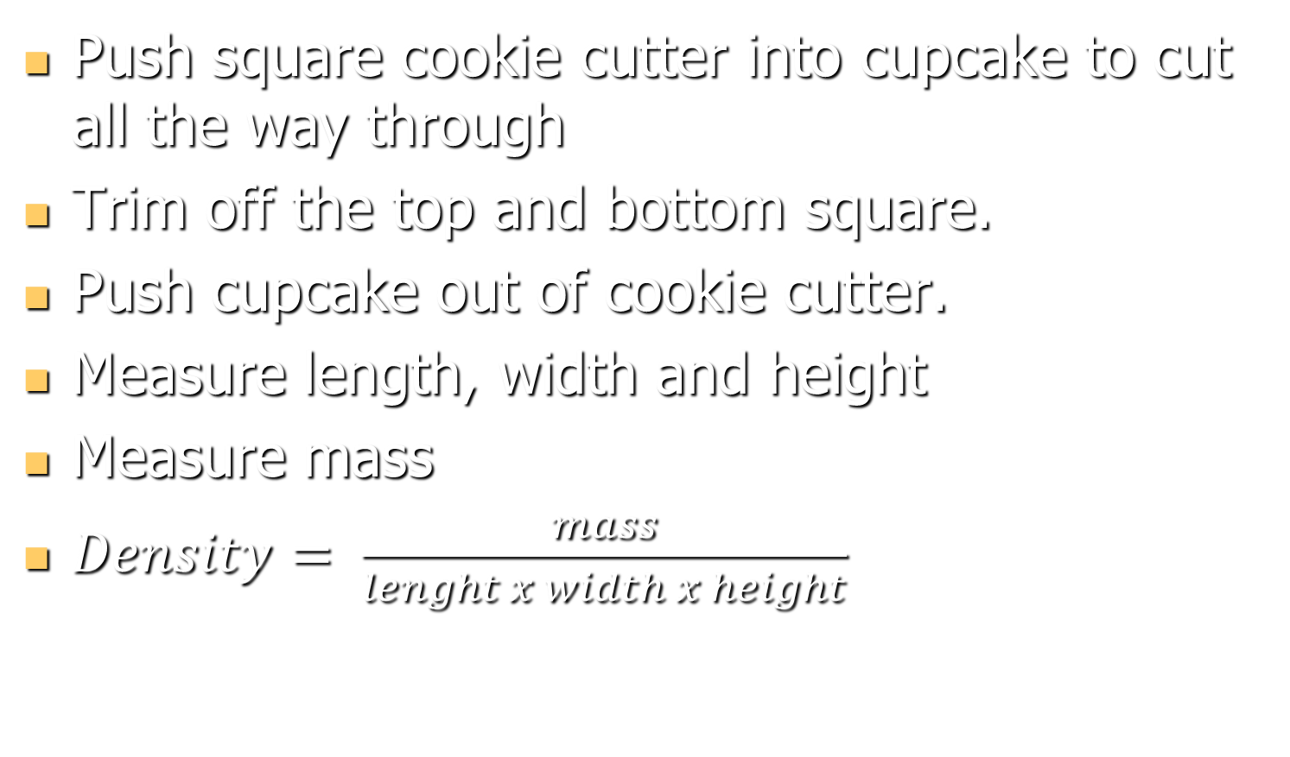
Measuring Density

Slide 30
Nutrition
Calorie - amount of heat required to raise the temperature of 1 gram of water 1 degree Celsius.
Kilocalorie (1000 calories) is the unit commonly used to represent energy values of foods -or Calorie with a C instead of a c
Not all carbohydrates (or fats, or proteins) yield the exact same amount of energy when burned in a calorimeter, so common averages from studies (in kcal/g) are used
Carbohydrates average 4.1 kcal/gram in a bomb calorimeter, are about 98% digestible and yield 4 kcal/g when consumed
Proteins average 5.7 kcal/g in a bomb calorimeter, are not as easily digested and yield an average of 4 kcal/g when consumed
Lipids average 9.5 kcal/g in a bomb calorimeter, are 95% digested and yield an average of 9 kcal/g when consumed
Fats (lipids) are the most concentrated source of food calories
Carbohydrates are the cheapest source of calories, proteins the most expensive

Slide 31
Fiber
Foods not digested by human digestive system
Two types
  Soluble Fiber-helps regulate blood sugar
    Found in Oats & Oat Bran, some Fruits & vegys
  Insoluble Fiber-helps clean out colon
    Found in whole wheat, some fruit skins and vegys

Slide 32
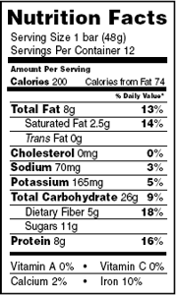
Nutritional labeling
  Fill in the following blanks.
    There are ___ Calories/gram of fat.
    There are ___ Calories/gram of carbohydrate
    There are ___Calories/gram of protein
    There are ___Calories/gram of water
  Use the nutritional label given for information to answer the following questions:
    Calculate the Calories in one serving of this product.
      Calories from Fat
      Calories from Protein
      Total Calories in one serving
    What percent of the carbohydrate Calories come from fiber?
    If the daily value of iron is 18 mg per day, calculate the amount (in mg) of iron in one bar of this product.

Slide 33
Resources
For Event Supervisors
  http://mypage.iu.edu/~lwoz/socrime/index.htm
For Lesson Plans for classroom use
  http://mypage.iu.edu/~lwoz/socrime/index.htm
https://gmoanswers.com
http://www.fda.gov/Food/IngredientsPackagingLabeling/FoodAdditivesIngredients/ucm094211.htm

Slide 34
Questions
Thank You

Slide 35
Time to Play
We can use a calorimeter to find the energy in Cheetos
We can find the density of muffins
We can work with some tests from a simulated test.
It is your option

Slide 36
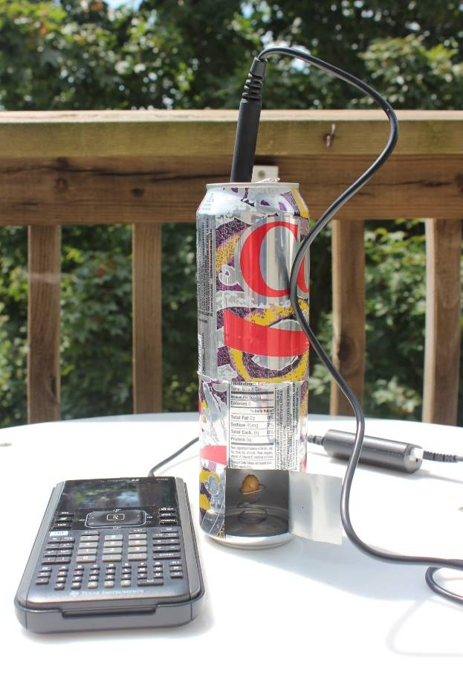
Making Calorimeter
Cut top off empty pop can
Cut “door” in the side of pop can
Wash out second empty pop can
Fit second can into first
Make a food holder by bending up a paperclip

Slide 37
Calibrate the Calorimeter
Put 100 ml of water in the top cup.
Measure the temperature of the water.
Weigh a tea candle.
Light the tea candle and immediately put it under the water.
Let it burn for ~4 minutes.
Blow out the candle and take the final temperature of the water
Reweigh the candle

Slide 38
Calibration Calculations
The accepted low heat value of paraffin wax is 41.5 kJ/g.
ΔH = mCΔT/n
M= 100 g – the water was 100 ml=100g
C=4.18 J/(g ◦K) = 1.0 cal/(g ◦C) for water
ΔT = difference in temperature of water
n= difference in mass of candle
Efficiency = ΔH/41.5/1000 (to change J to kJ)

Slide 39
Sample Test
Put a little of each of the drink mixes in a different well of the spot plate
Put a drop of Iodine solution on each
Which ones turn blue black?
Put a new sample of each drink mix into a different well of the spot plate.
Put a drop of NaOH on each
Put a drop of Benedicts solution on each
Stir – Which ones turn purple?

Slide 40
Sample Test continued
Put a little of each drink mix in a different test tube. (It is best to have each table do a different mix here)
Add 5 drops of Benedict’s solution
Put the test tubes in a hot water bath
What colors do the turn?

Slide 41
Density
Determine the dimensions of your coffee cake
Determine the mass of your coffee cake
Determine the density of your coffee cake.

Slide 42
Using the Calorimeter
Mass a Cheetos
Impale it on a bent paperclip
Prepare your calorimeter
Find the initial temperature of 100 ml DI
Move outside or under a hood
Light the Cheetos with a match & immediately put it under the water
When the Cheetos stops burning, take the final temperature of the water
Take the mass of the burned Cheetos

Slide 43
Calculations
Determine ΔH = mCΔt/n=100(4.18)Δt/n
Divide by 1000 to turn to kJ/g
Divide by the efficiency of your system
Divide by 4.186 to change to Calories
Compare to accepted value of Cheetos Crunchy of 5.17 Calories/g

