Slide 1
Tree Identification

Slide 2
Forested
The definition of forested (land that is forested or has trees growing on it): to be classified as forested (forestland) the area must be at least one acre and contain at least 10% tree cover.

Slide 3
Dendrology
‘Dendro-’ from the Greek word meaning tree
‘-ology’ meaning the study of
Dendrology is the study of trees and includes taxonomy, identification, silivical characteristics, ranges, morphology, and ecology

Slide 4
What makes a tree a tree?
Heights at least 4.5 meters (about 15 feet)
Single dominant woody stem (trunk or bole)
Capable of diameter growth
Perennial plant (present at all seasons of the year)

Slide 5
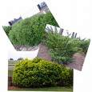
What makes a shrub a shrub?
Heights under 4.5 meters (less than 15 feet)
Multi-stemmed
Capable of diameter growth
Perennial plant

Slide 6
Tree Identification
By observing leaves

Slide 7
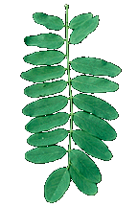
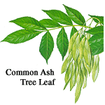
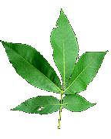
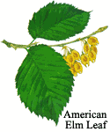
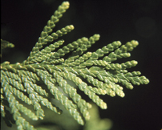
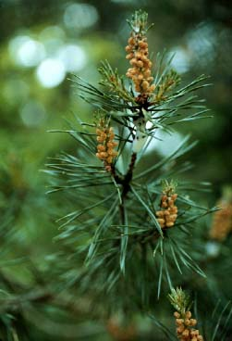
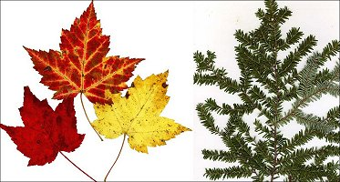
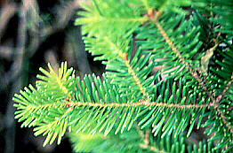
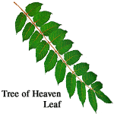
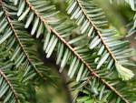
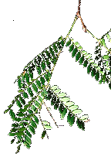
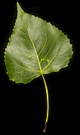
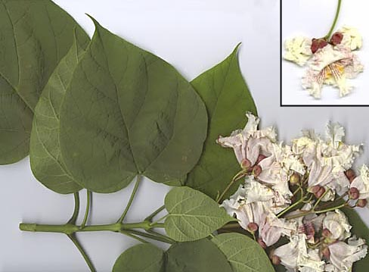
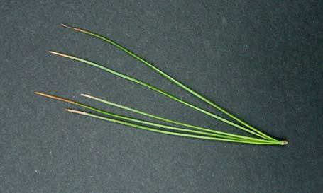
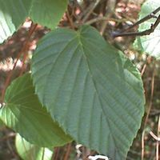
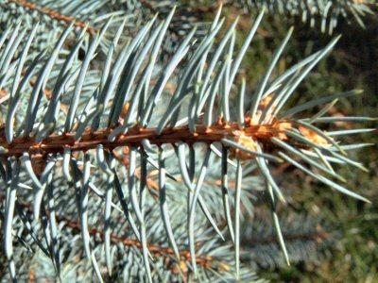
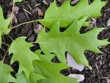
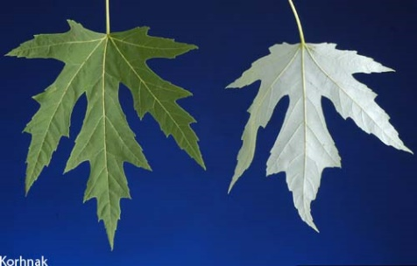

Slide 8
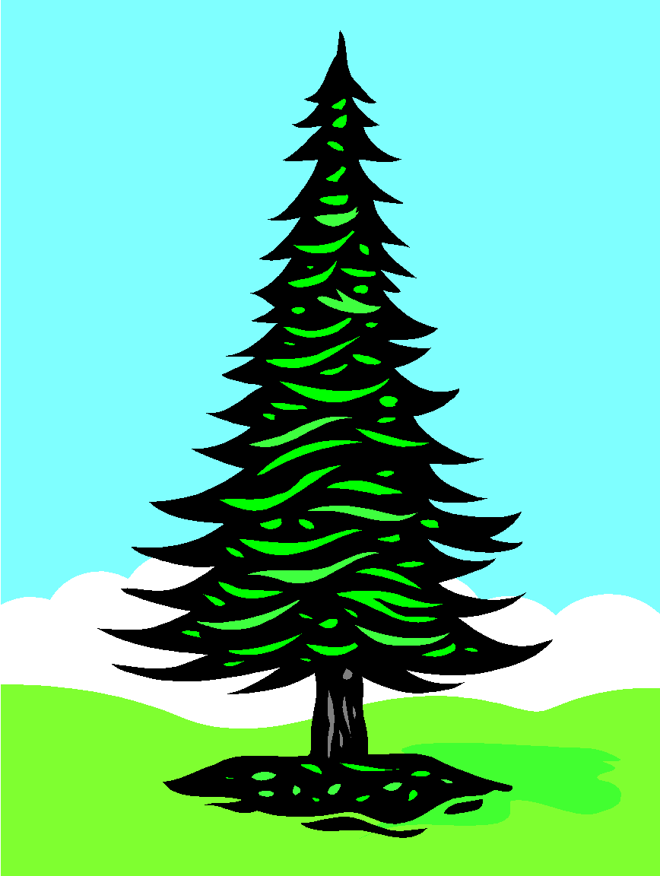
Conifers vs. Deciduous
Notes:
8
In the simplest sense there are two kinds of trees in the world.

Slide 9
Which is Which?

Slide 10
Characteristics of Conifers
Needle shaped leaves
Seeds that develop inside cones
Evergreen – green year round
Gymnosperm, conifer, softwood
Examples: pine, spruce, hemlock, fir

Slide 11
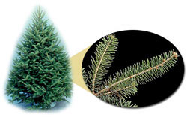
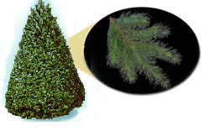
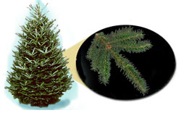
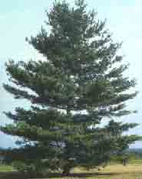
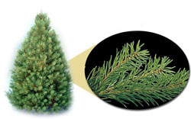
Examples of conifers
Balsam fir
Red pine
Douglas fir
Fraser fir
Scotch pine
White pine

Slide 12
Conifer leaves
Needle like
Scale like

Slide 13
Conifer needles
Clusters
Singles

Slide 14
Deciduous Tree Characteristics
Broad flat leaves
Lose all leaves each year in the fall
Angiosperm (flowering plants), broadleaf, hardwood
Examples: oak, maple, beech, aspen, ash

Slide 15
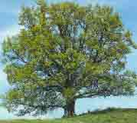
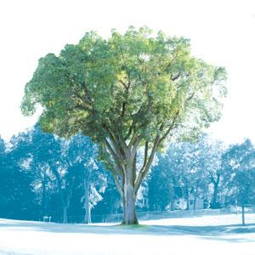
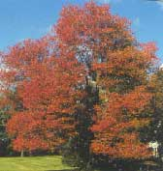
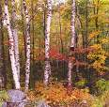
Deciduous examples
Red oak
Elm
Honey locust
Red maple
Black locust
White Birch
Beech
Crimson king

Slide 16
Leaf characteristics-deciduous
Leaf arrangement: whorl, alternate, opposite
Leaf type: simple or compound
Leaf edge: entire (smooth), lobed (projection), toothed (serrated)
Leaf texture: hairy, waxy, rough, smooth, thick, thin, etc.
Leaf shape: various

Slide 17
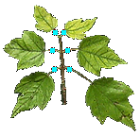
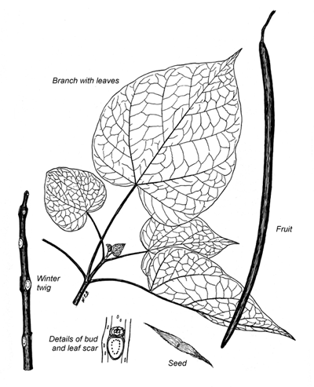
Leaf Arrangement
alternate opposite whorl

Slide 18
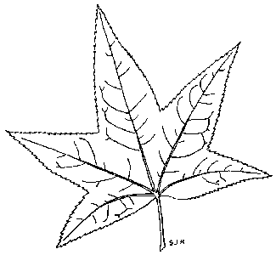
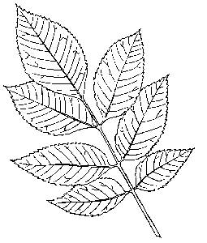
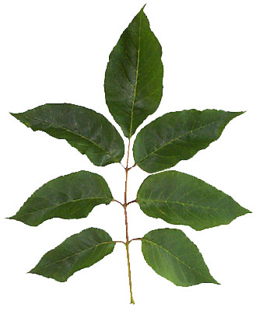
Leaf Type Simple vs. Compound
Notes:
18
Sweet gum and ash

Slide 19
Simple Compound
Only one leaf blade
Joined by its stalk to the woody stem
Examples: maple, oak, aspen, beech
Made up of several leaflets
Leaflets are joined to a midrib that is not woody
Examples: ash, walnut, sumac

Slide 20
Simple or Compound?

Slide 21
What is the leaf type?

Slide 22
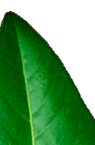
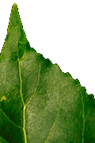
Leaf Edge Lobed , smooth, toothed?

Slide 23
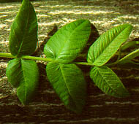
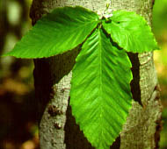
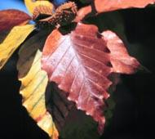
Leaf Texture

Slide 24
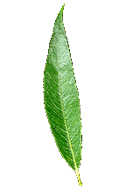
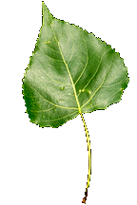
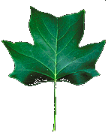
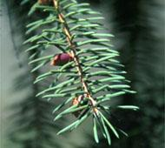
Leaf Shape

Slide 25
More characteristics to ID trees
Bark
Twigs
Flowers
Fruits/Seeds
Cones
Overall shape

Slide 26
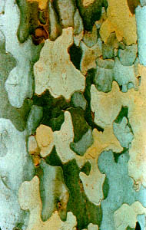
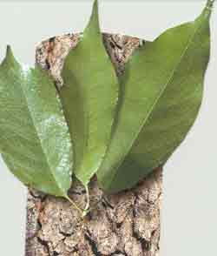
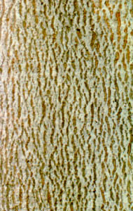
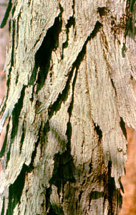
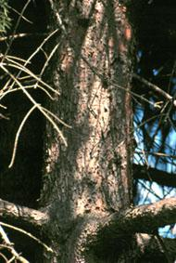
Bark
Color
Texture
Furrows
Age
Thorns

Slide 27
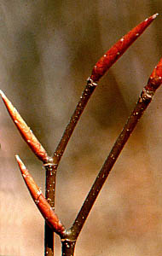
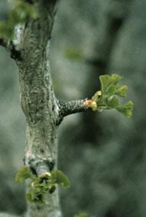
Twig clues
Leaf scars aka buds are the places where the leaves used to be attached
Size color and shape of buds also useful to ID trees

Slide 28
Flower clues
Shape
Color
Texture
Size

Slide 29
Fruits & Seeds

Slide 30
Cones

Slide 31
Overall shape

Slide 32
Leaf Observations
Deciduous | Conifer
Leaf arrangement: Alternate, opposite, whorl | Needles or scales
Leaf type: Simple, compound | Needle attachment: Single, clusters
Leaf edge: Entire, lobed, toothed

