Slide 1
WRITE IT DO IT

Slide 2
The Competition
Writer
One member will write a description of an object
Builder
Their partner will construct the object from the description in a separate room

Slide 3
Time Allocations
Writing
25 minutes
Time not a factor
Doing/Building
20 minutes
Time is used as a tie-breaker

Slide 4
Objects and Materials
Same Objects/Models and Materials are used for all teams

Slide 5
Examples of Possible Materials
Toys
Legos, K’Nex, Tinker Toys, etc.
Raw Materials
Office Supplies – index cards, paper clips, push pins, labels, post-it notes, rubber bands, etc.
Arts & Crafts Supplies – pipe cleaners, beads, stickers, Styrofoam balls, plastic mesh, yarn, etc.
Other – paper cups, cupcake papers, straws, nails, nuts & bolts, packing peanuts, foam packing, popsicle sticks, etc.

Slide 6
Written Description
Allowed
Numerals
Words
Single letters
All must fit within the context of the written description

Slide 7
Written Description
Not Allowed
Drawings
Diagrams

Slide 8
Written Description Symbols
Any symbol that could be interpreted as a diagram must fit within the context of the written description.
e.g. –
joined at 45º is allowed
Joined at is not allowed

Slide 9
Scoring
Winner is the Team that:
Builds the object nearest to the original model
AND has properly written instructions
Tie-Breaker:
Shortest time of construction

Slide 10
Scoring
Points awarded for each piece, compared to original model:
Proper Size
Proper Color
Proper Orientation
Proper connection
Proper location
Pieces connected correctly beyond an incorrect connection will be counted
No Penalty for unused parts

Slide 11
Scoring Violations
Drawing a subsection of the model will be ranked in Tier 2
Drawing a picture of the model will result in disqualification

Slide 12
Strategy
Practice, Practice, Practice
Helps identify the best writer/builders
Helps define rule system for writing
Terminology
Potential definitions
Potential abbreviations

Slide 13
Orientation of Parts of the Object
Cardinal Points
North
East
South
West
Compass Rose
Clock Face

Slide 14
Estimating Distances
Most tournaments do not provide one object/model per team so…
Writers are not allowed to touch the object/model
Almost impossible to measure distances exactly so teams will need to estimate
Metric is better than Standard Measurement
Have knowledge of common sizes/distances/

Slide 15
Use Texting Skills
Be Clear and Concise
Do not use unnecessary words
Cannot create “new” words
Proper grammar is not critical
Write in bullet points
Partner must be able to make sense of what is written
AND Judges MUST be able to understand what is written!!!

Slide 16
Checking Work
Writer
If time is left
Reread your writing
check for clarity
Doing/Builders
If time is left
check work
Remember time is used as a tie-breaker (but it doesn’t matter if your model isn’t correct)

Slide 17
Example Rubric

Slide 18
Blank Rubric

Slide 19
Example Rubric #2

Slide 20
Practice Examples

Slide 21
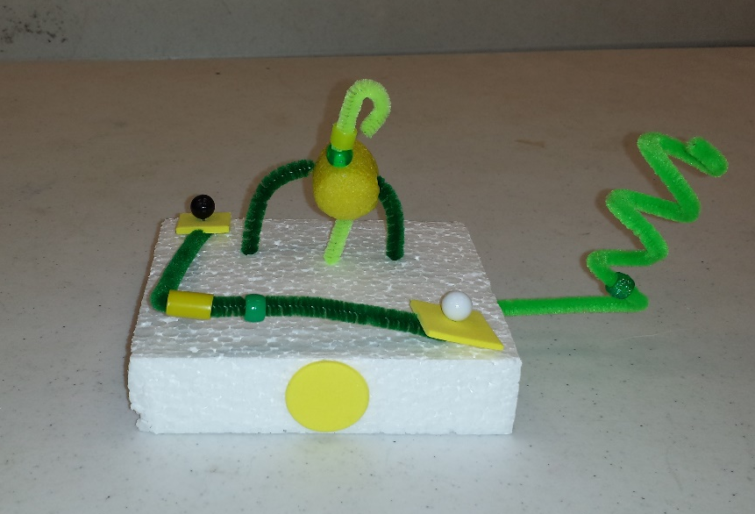

Slide 22
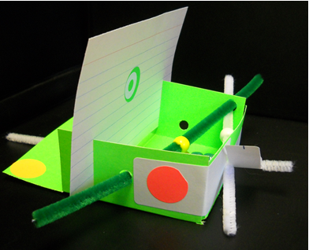
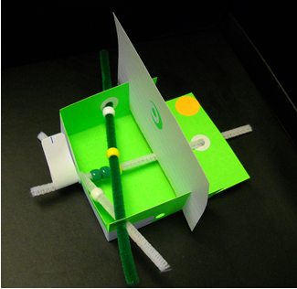
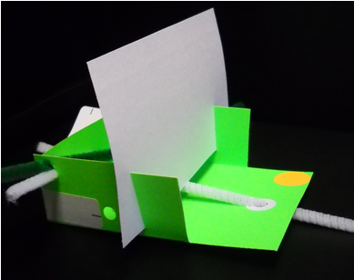
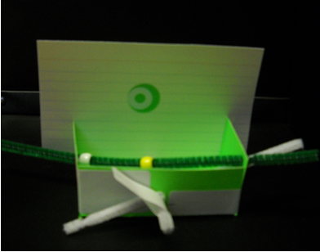

Slide 24
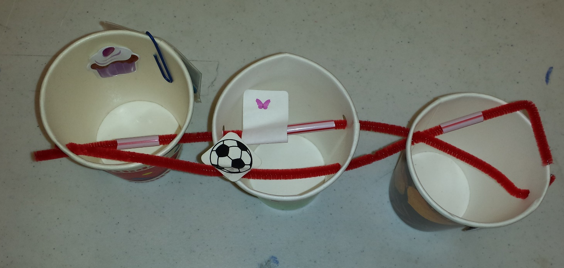

Slide 25
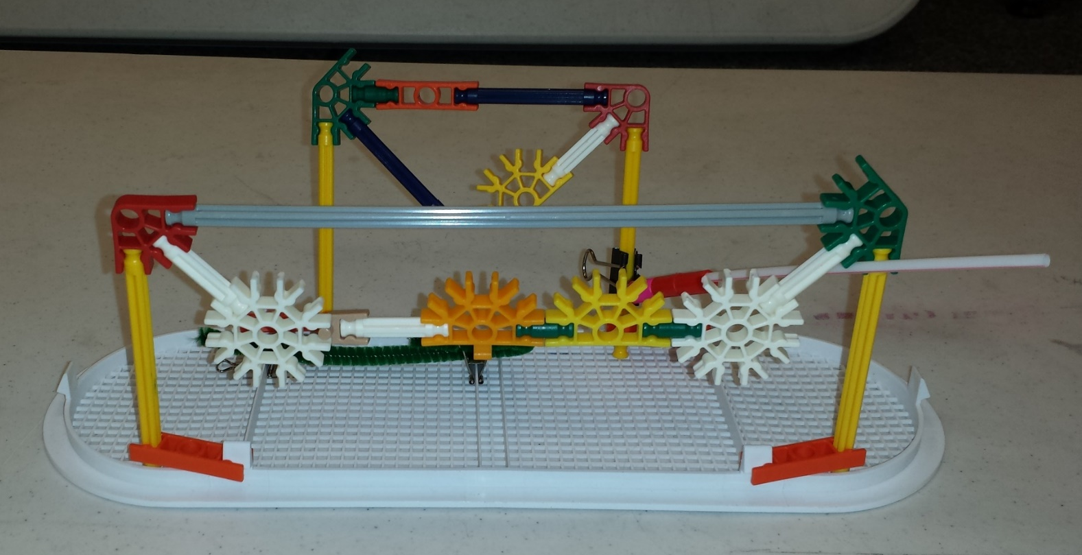

Slide 28
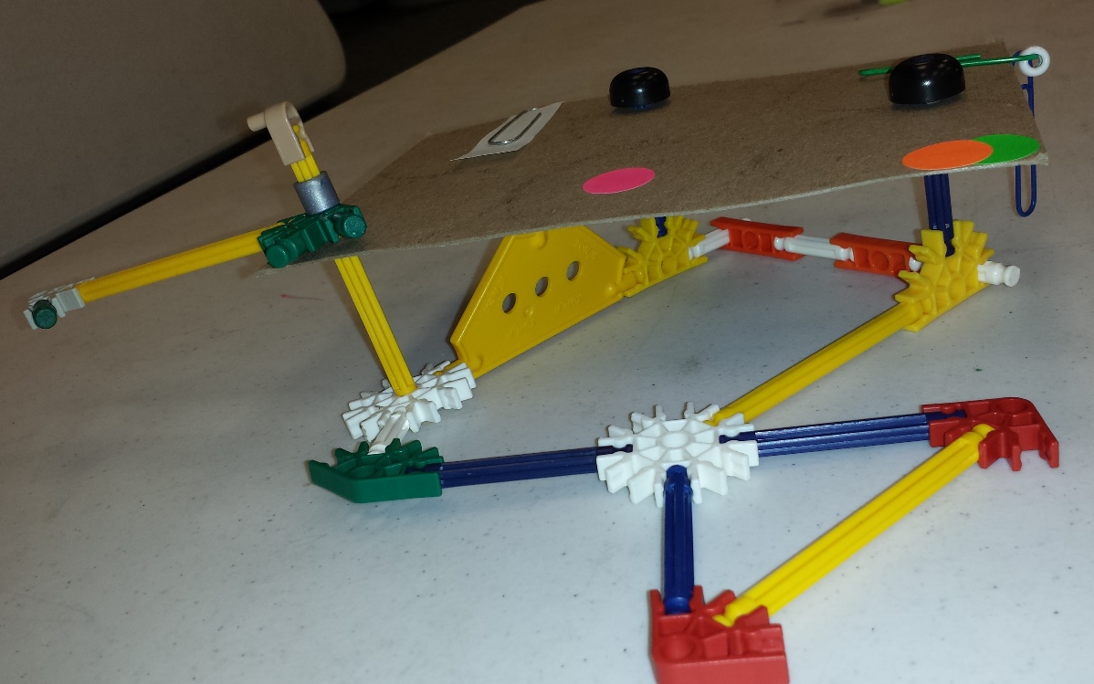
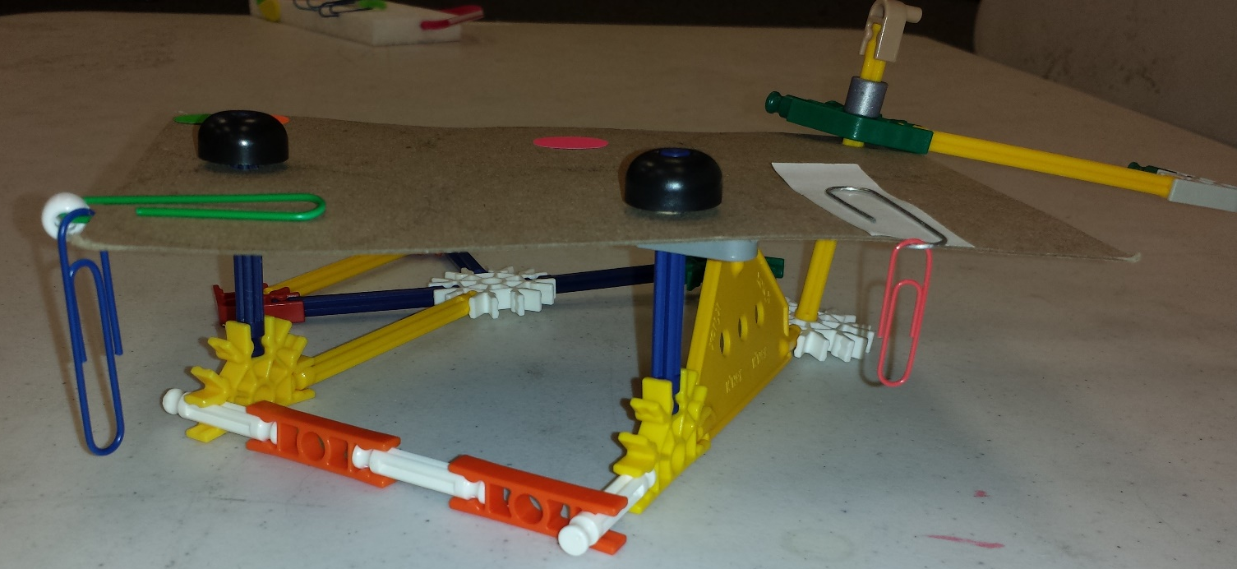

Slide 29
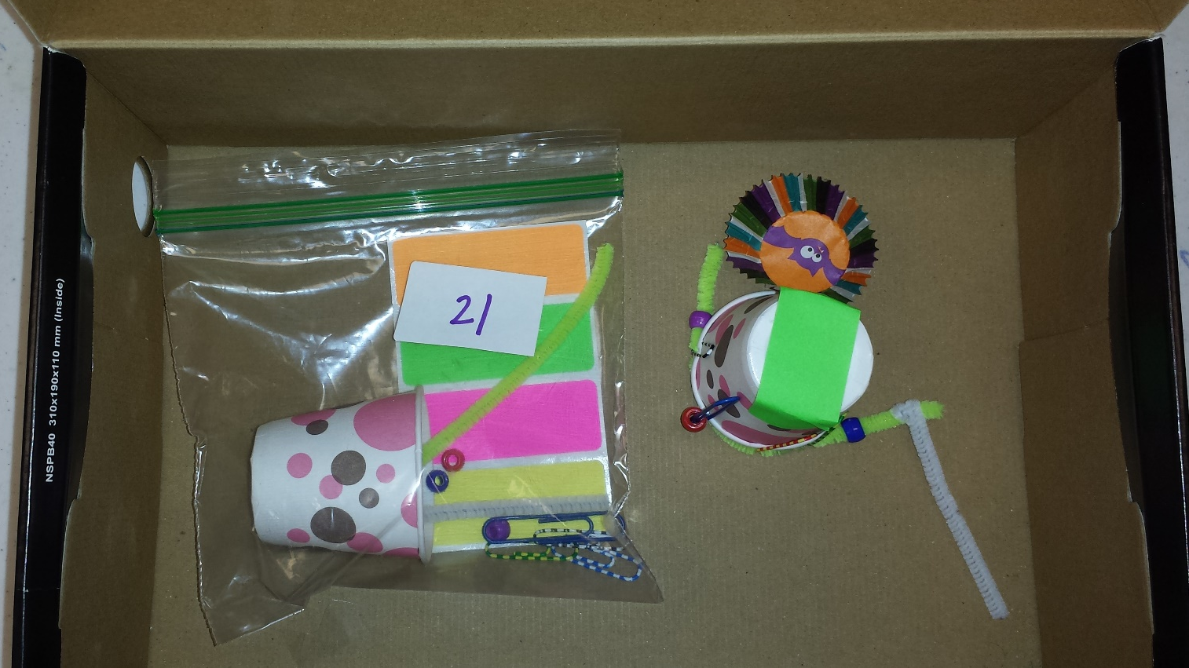

Slide 31
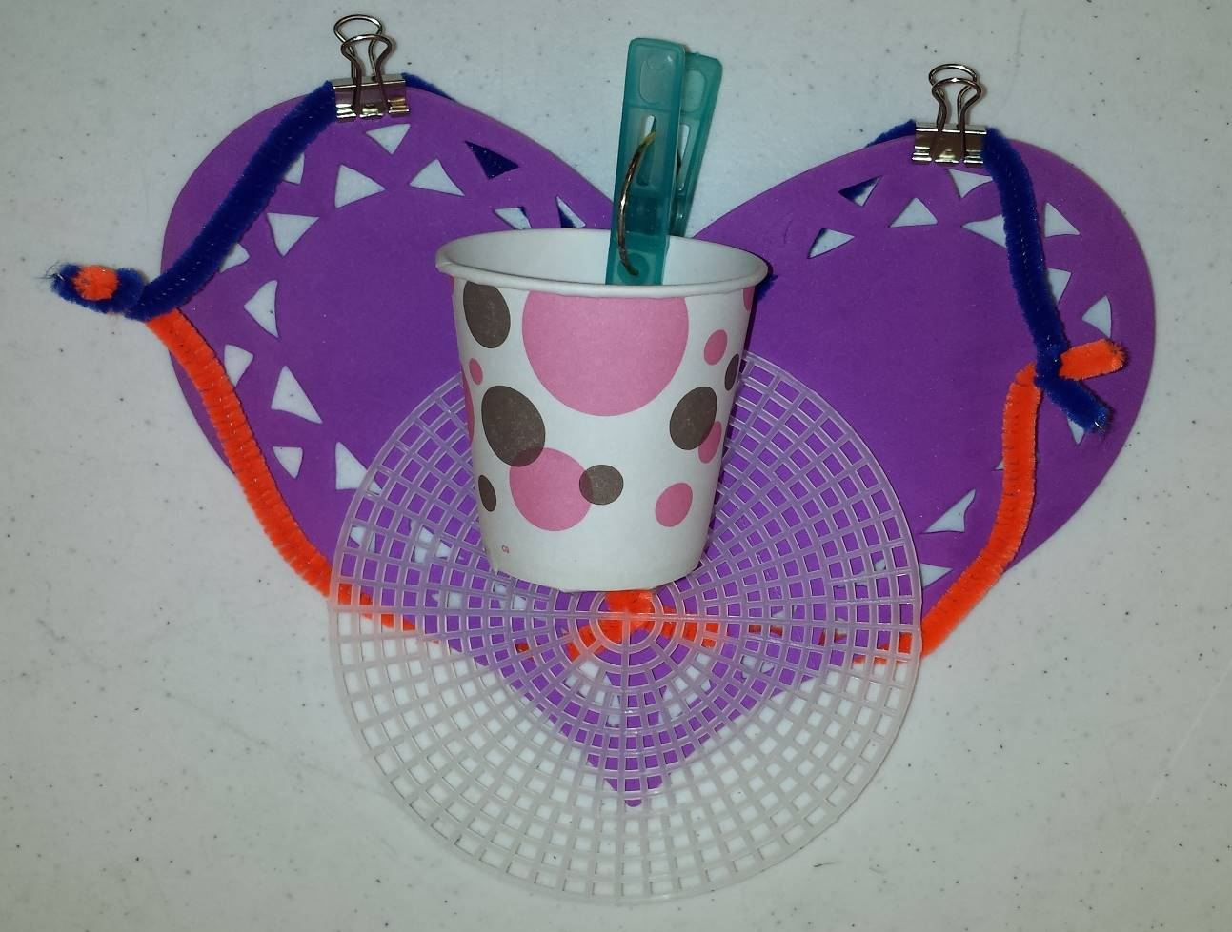

Slide 35
The WIDI Closet

